Slide 1
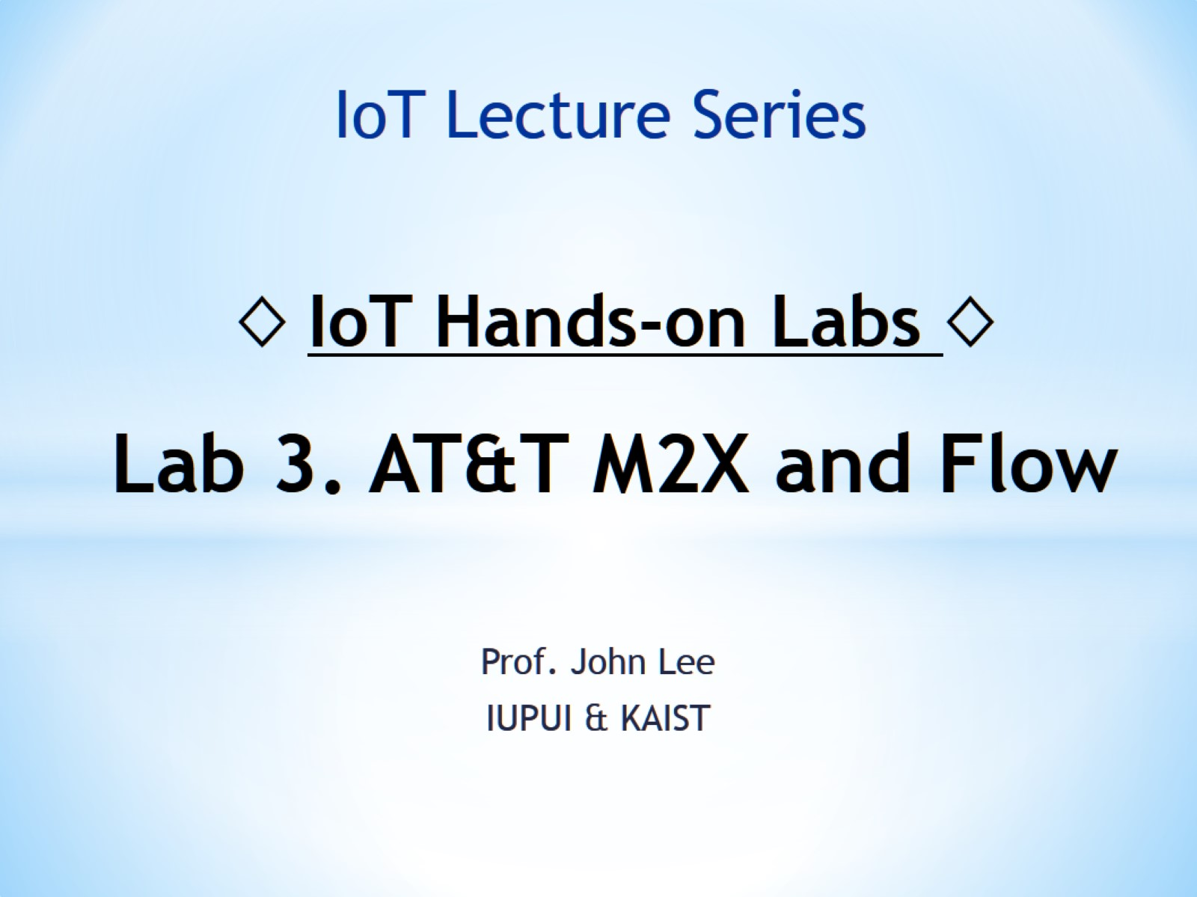
◊ IoT Hands-on Labs ◊ Lab 3. AT&T M2X and Flow

Slide 2
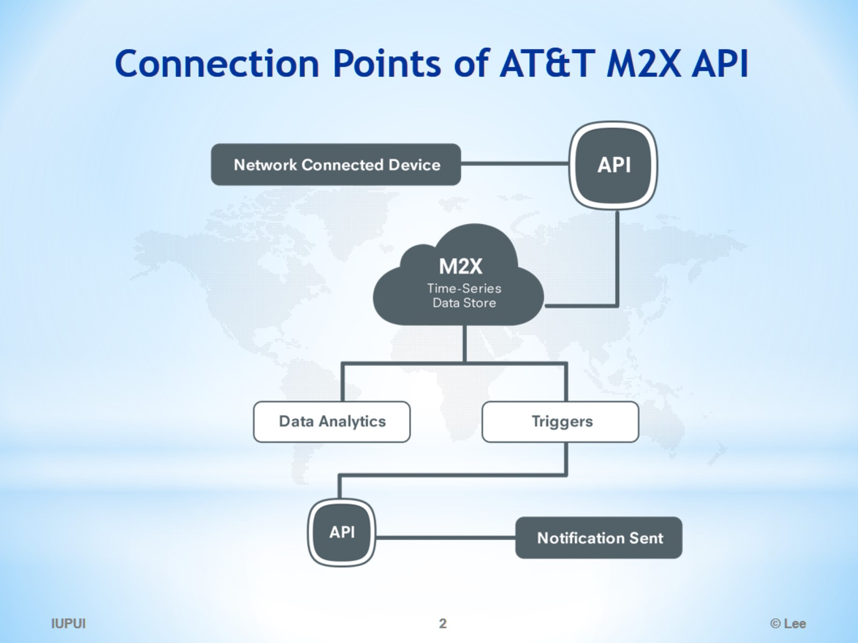
Connection Points of AT&T M2X API

Slide 3
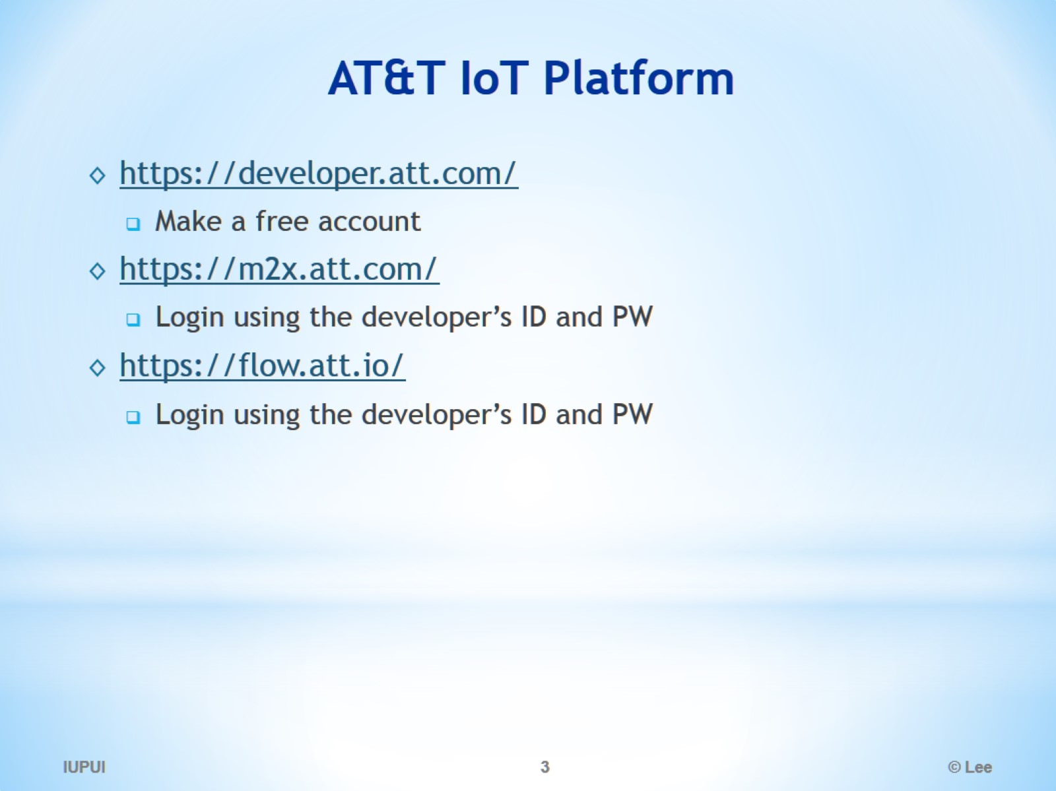
AT&T IoT Platform

Slide 4
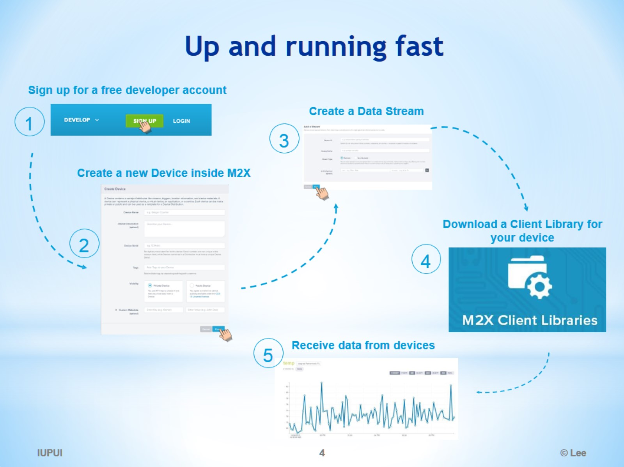
Up and running fast

Slide 5
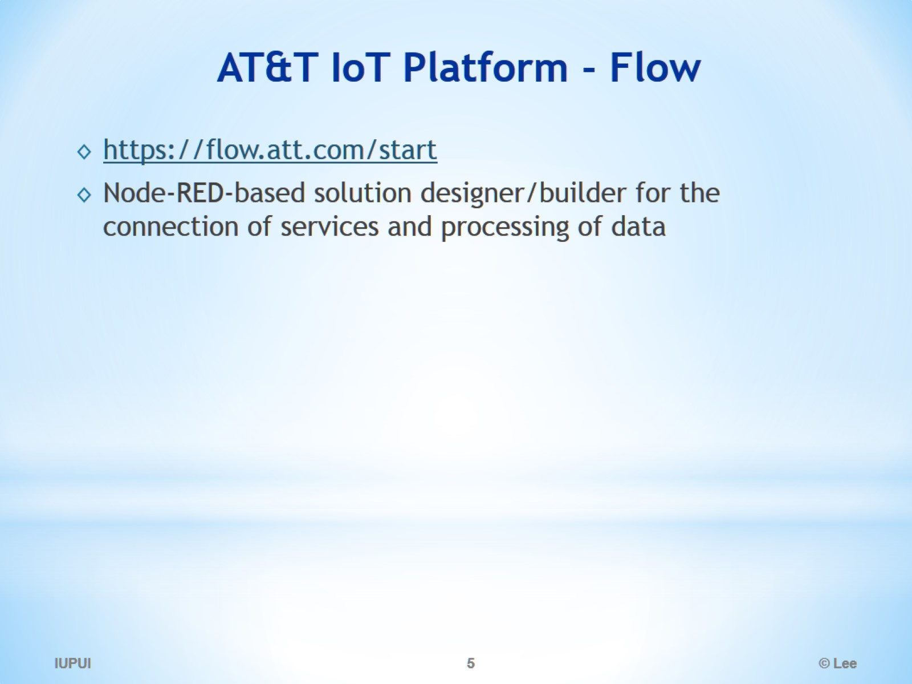
AT&T IoT Platform - Flow

Slide 6
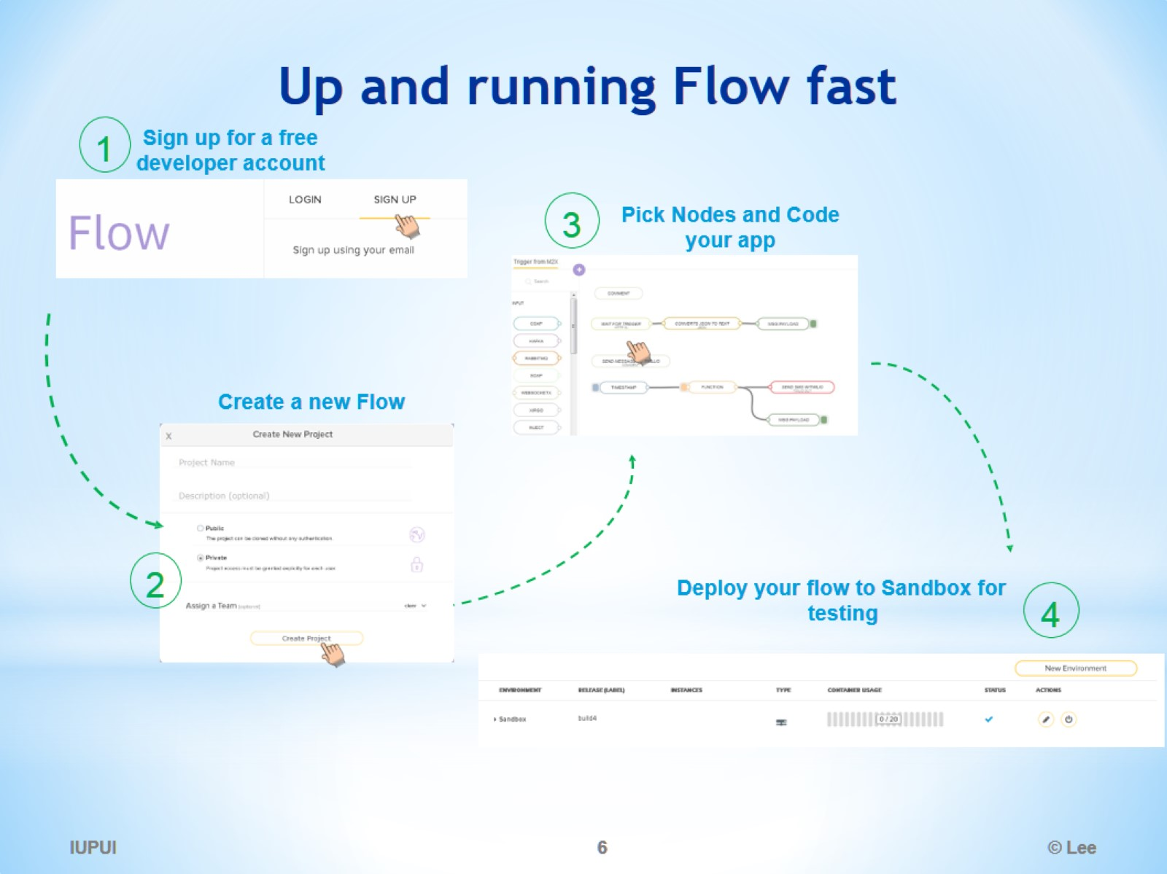
Up and running Flow fast

Slide 7
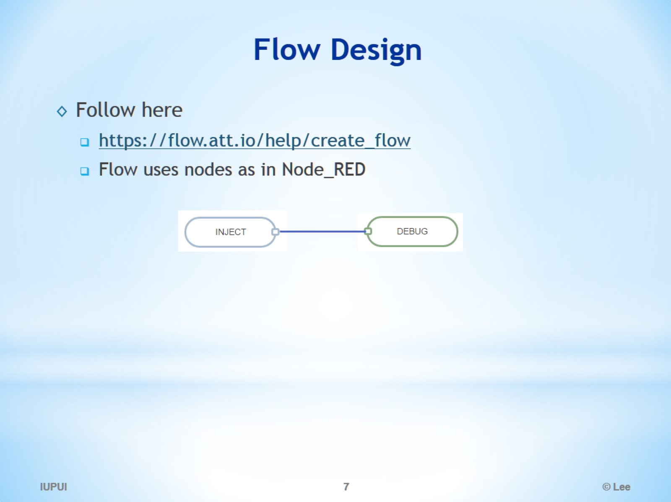
Flow Design

Slide 8
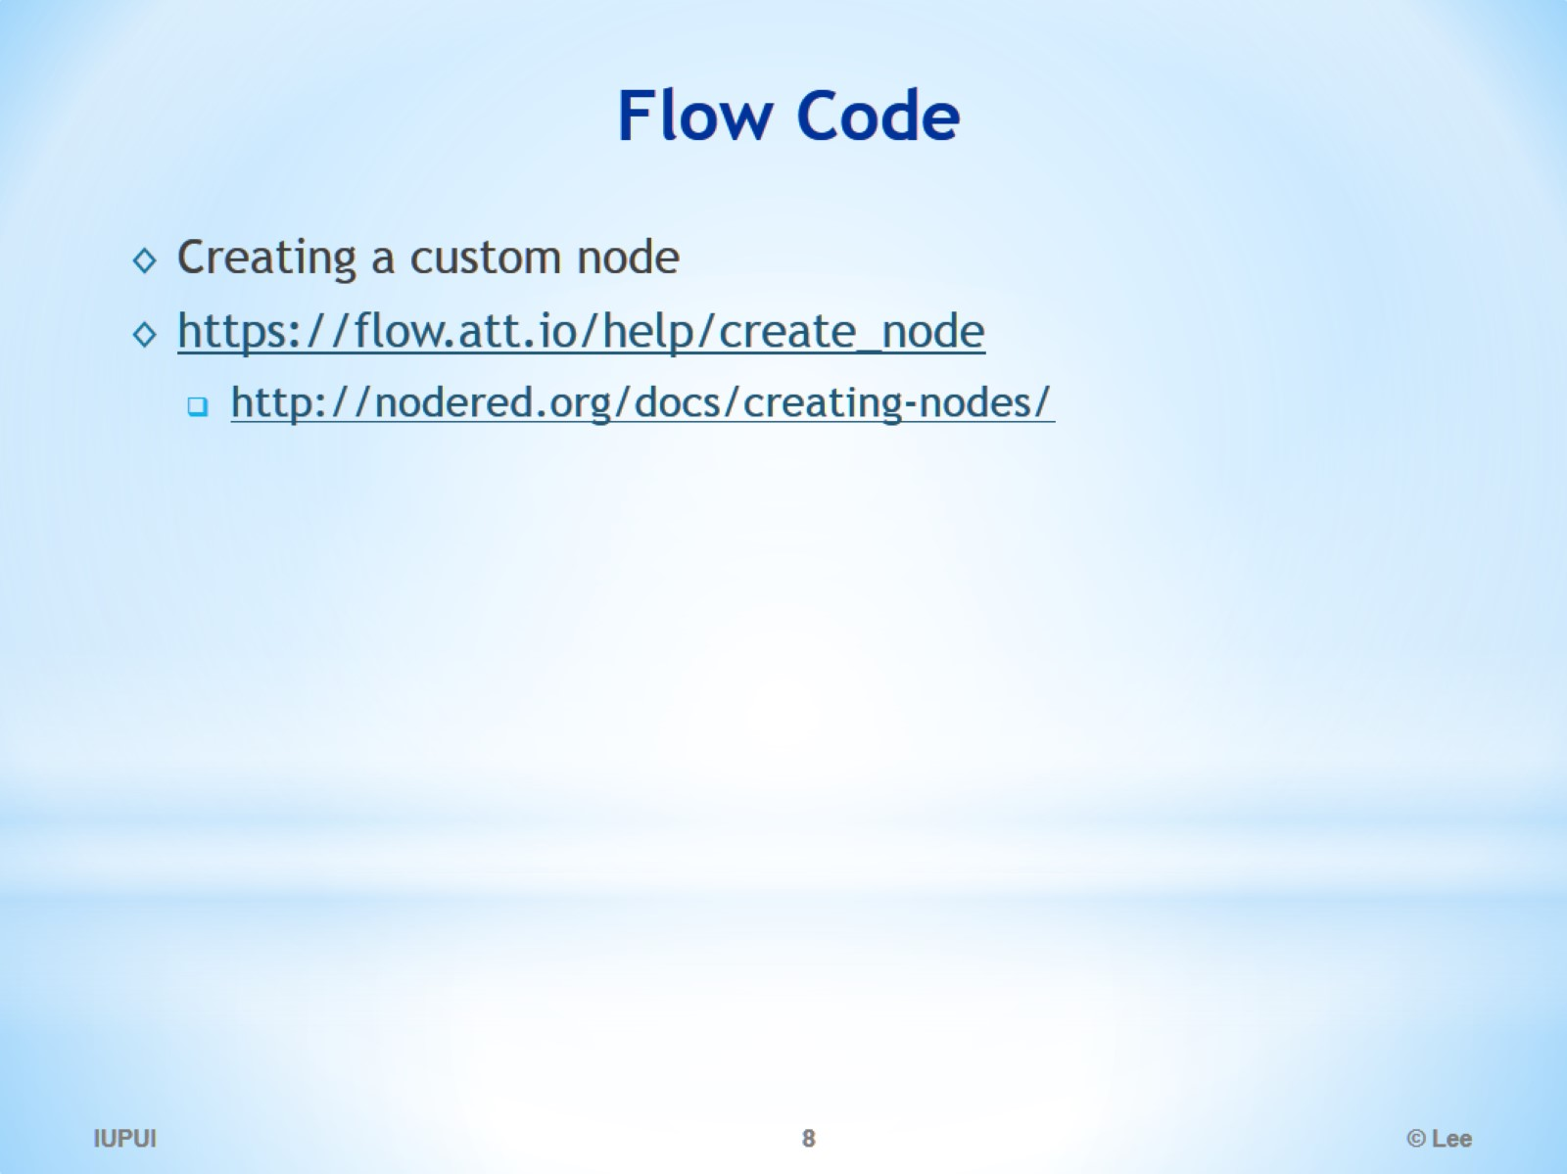
Flow Code

Slide 9
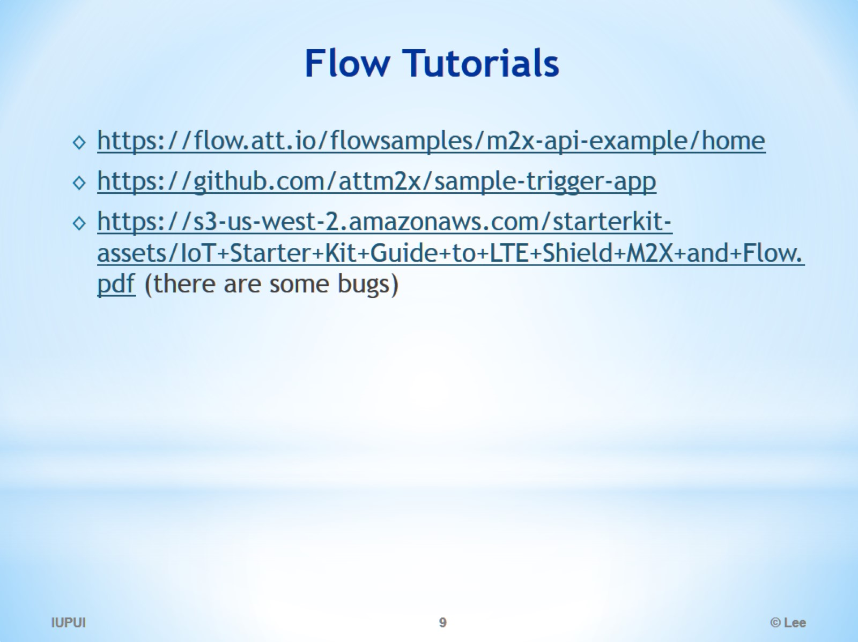
Flow Tutorials

Slide 10
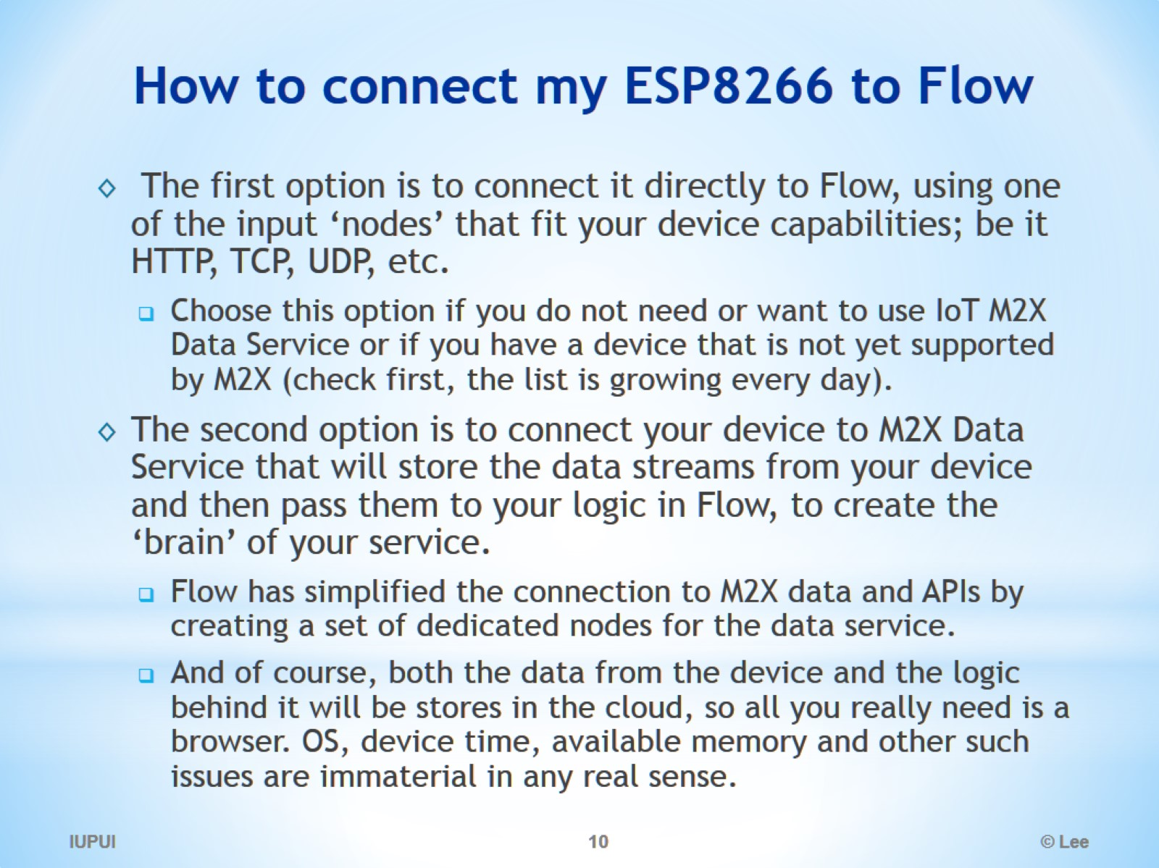
How to connect my ESP8266 to Flow

Slide 11
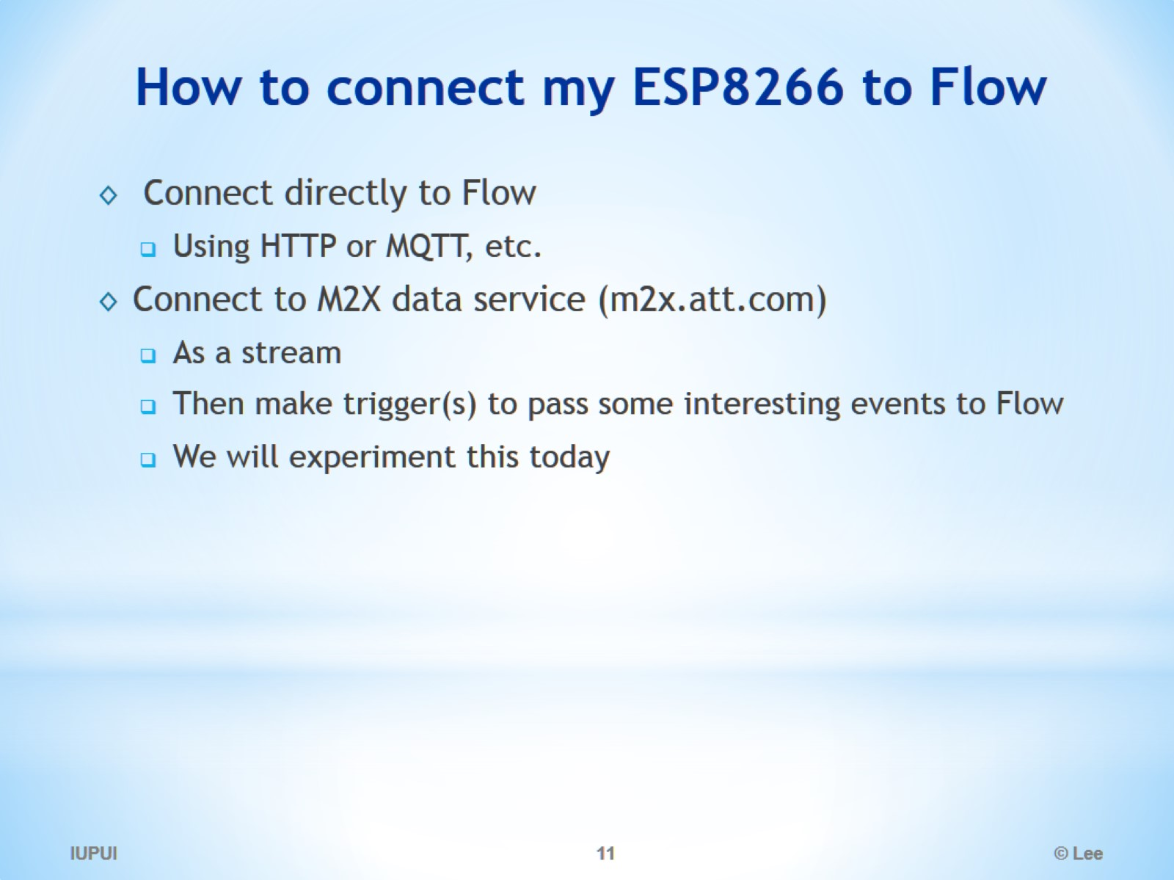
How to connect my ESP8266 to Flow

Slide 12
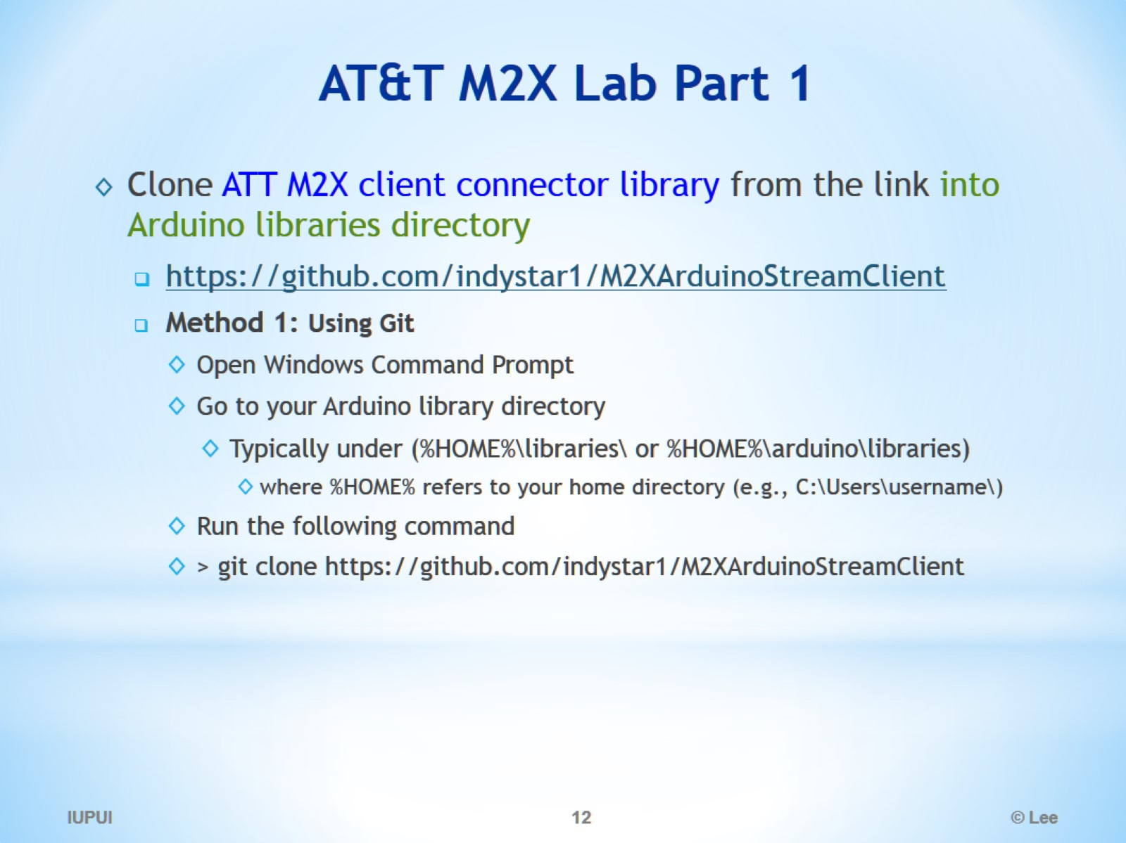
AT&T M2X Lab Part 1

Slide 13
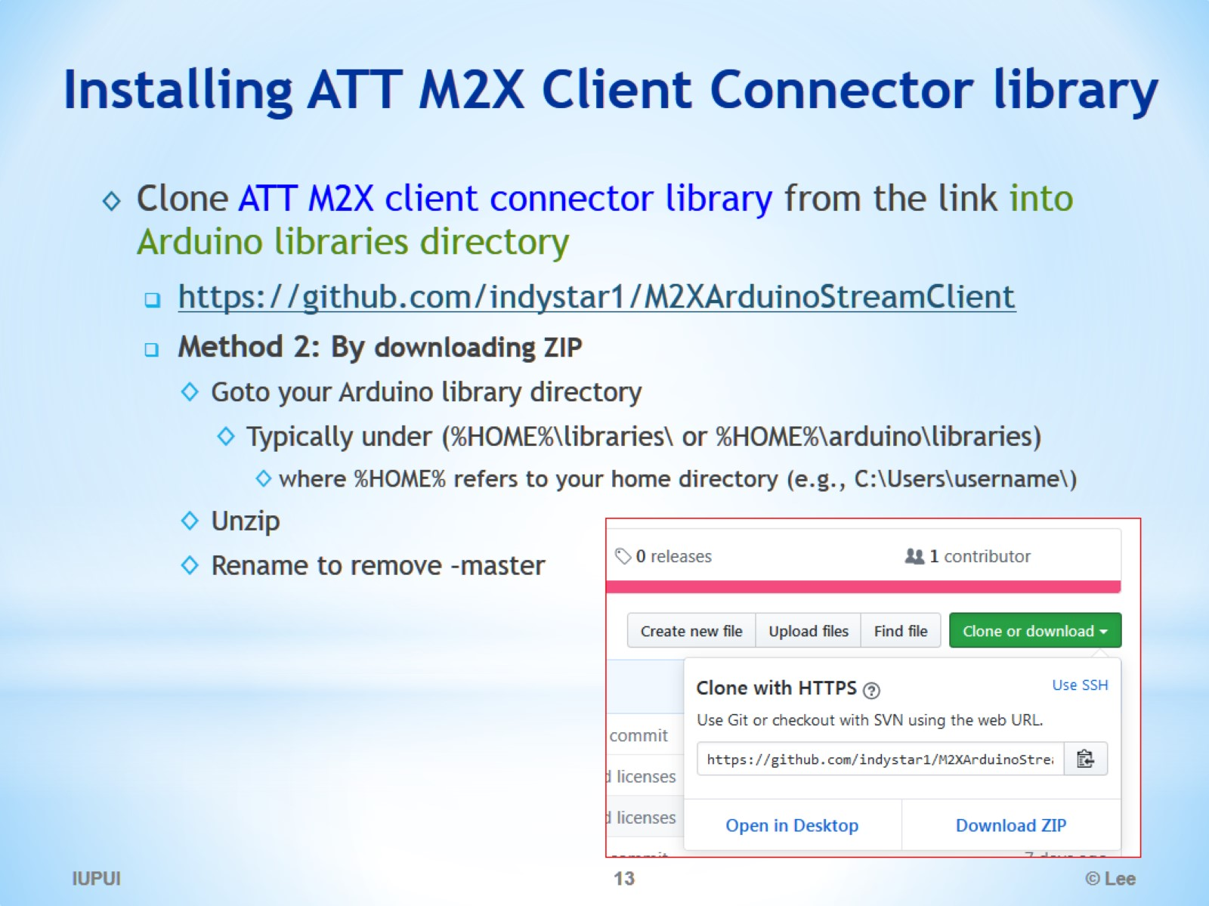
Installing ATT M2X Client Connector library

Slide 14
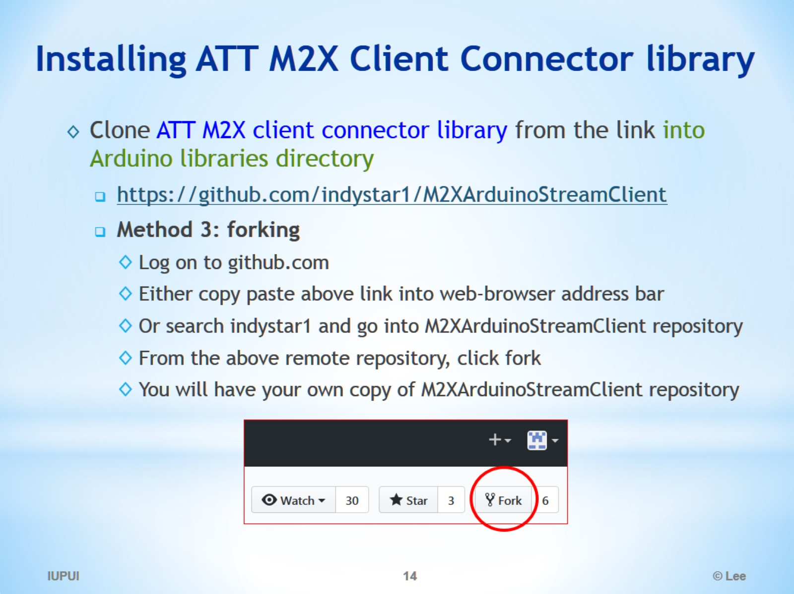
Installing ATT M2X Client Connector library

Slide 15
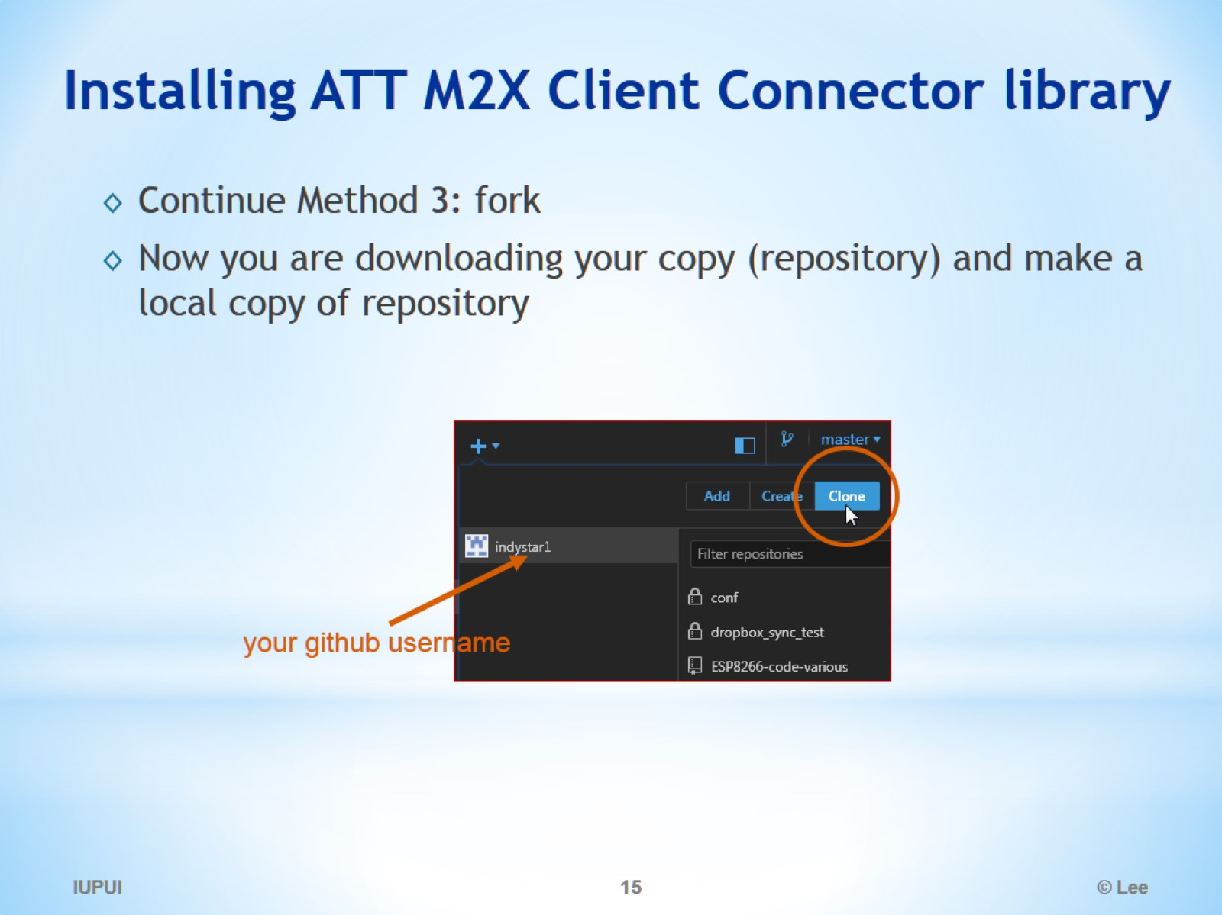
Installing ATT M2X Client Connector library

Slide 16
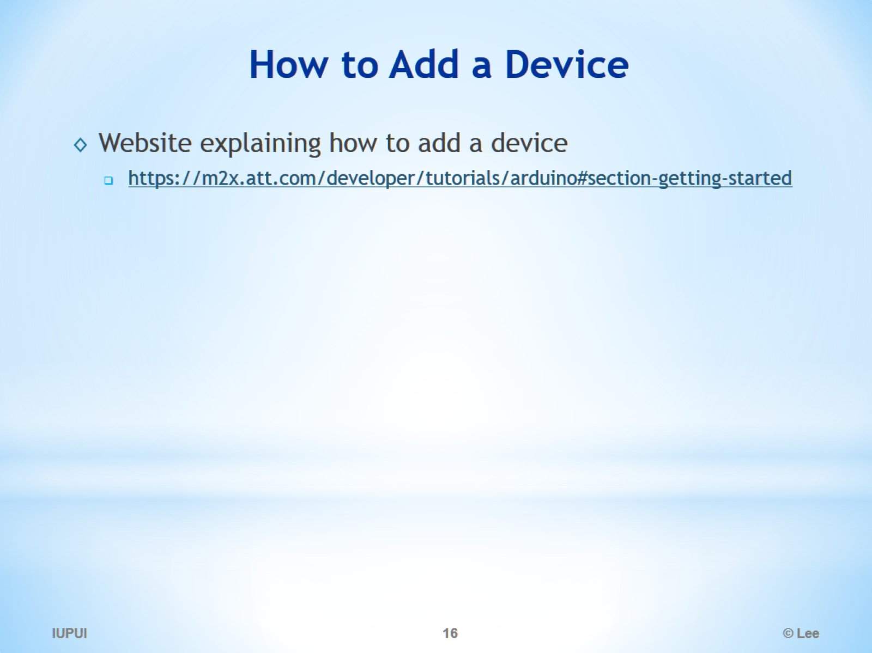
How to Add a Device

Slide 17
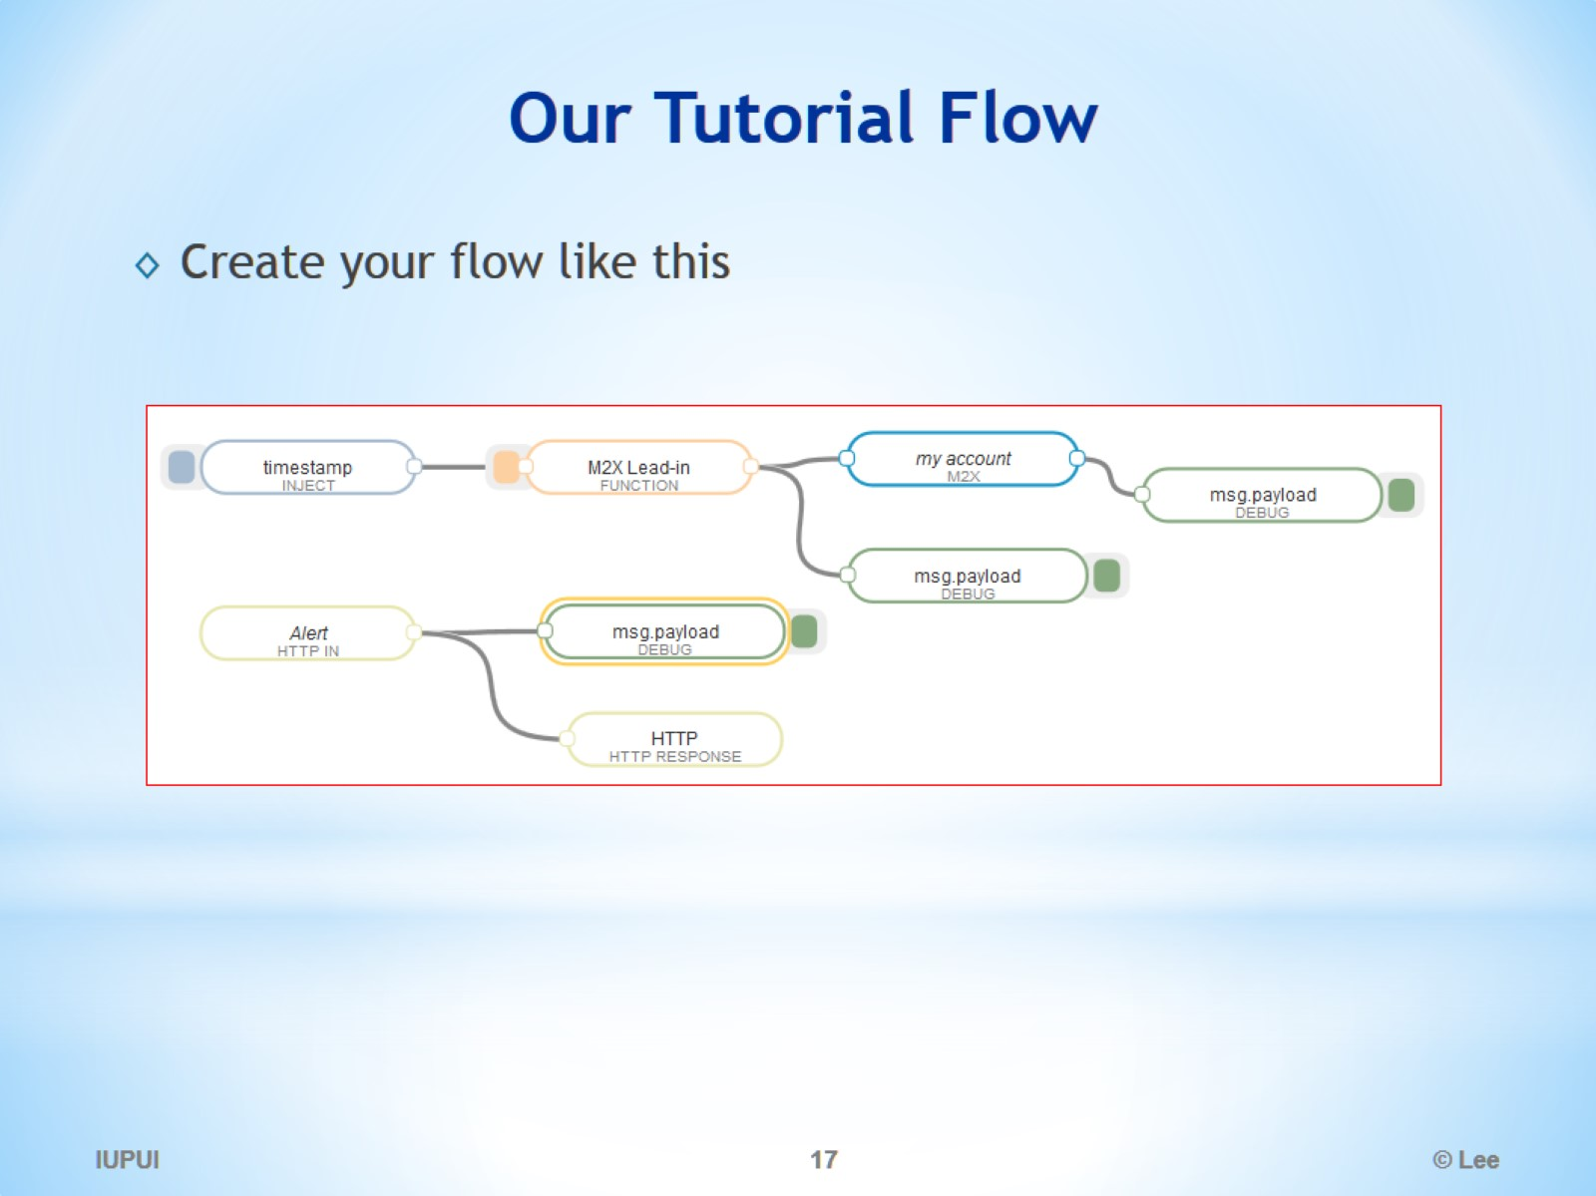
Our Tutorial Flow

Slide 18
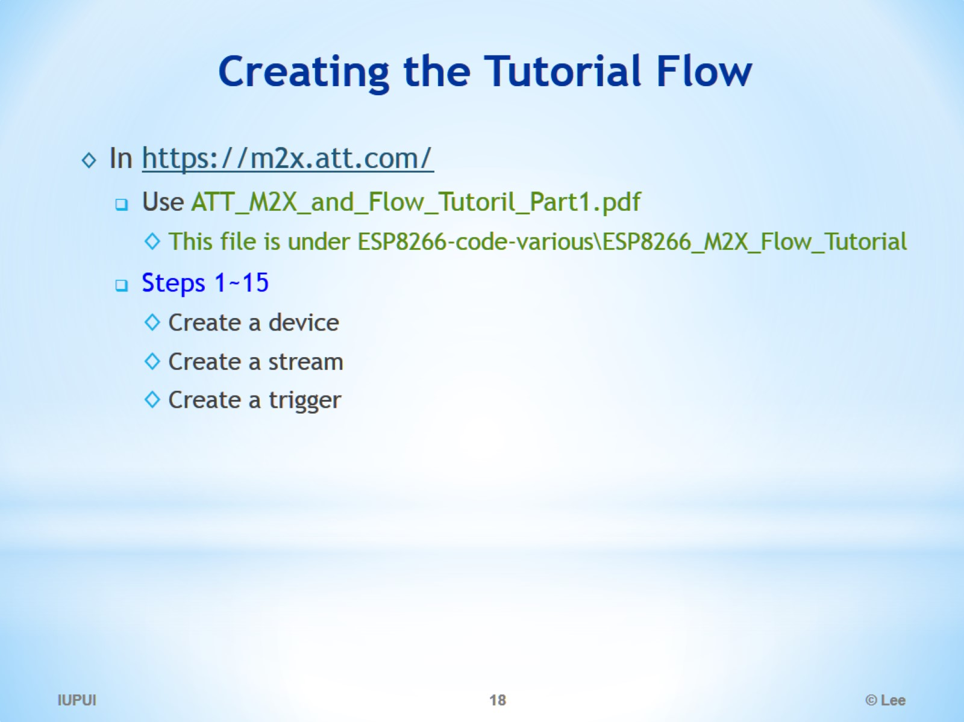
Creating the Tutorial Flow

Slide 19
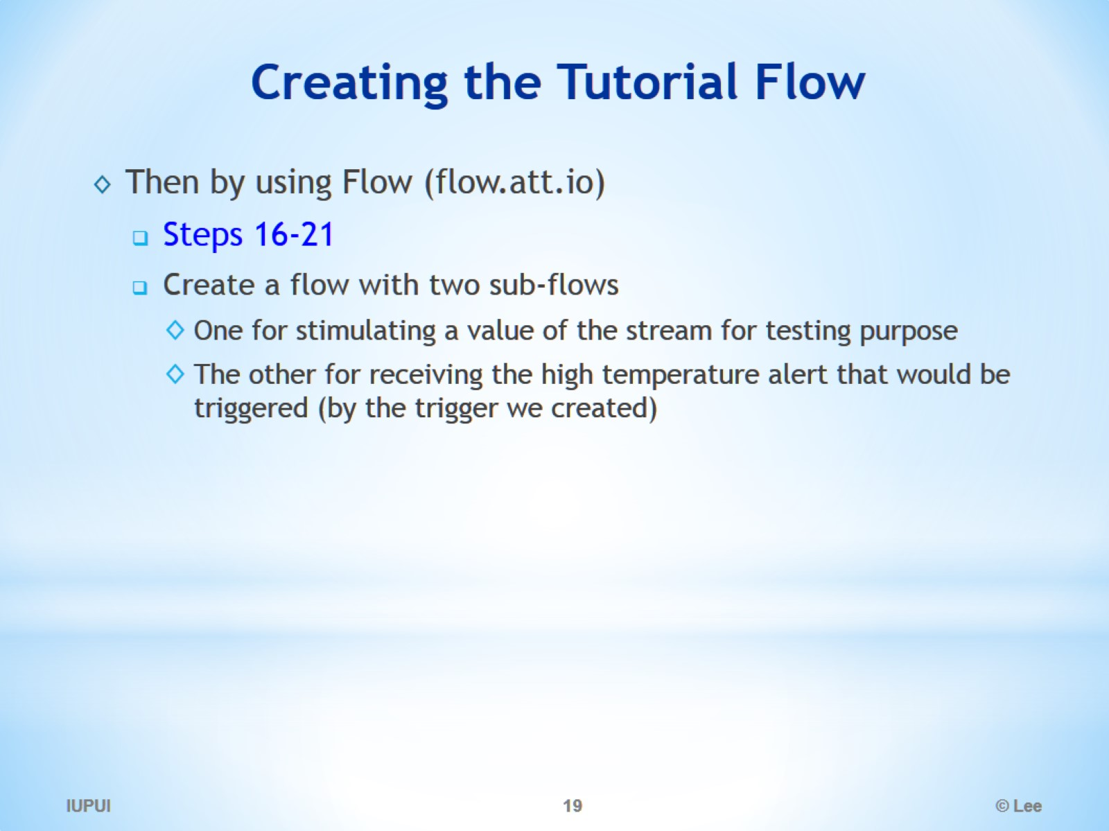
Creating the Tutorial Flow

Slide 20
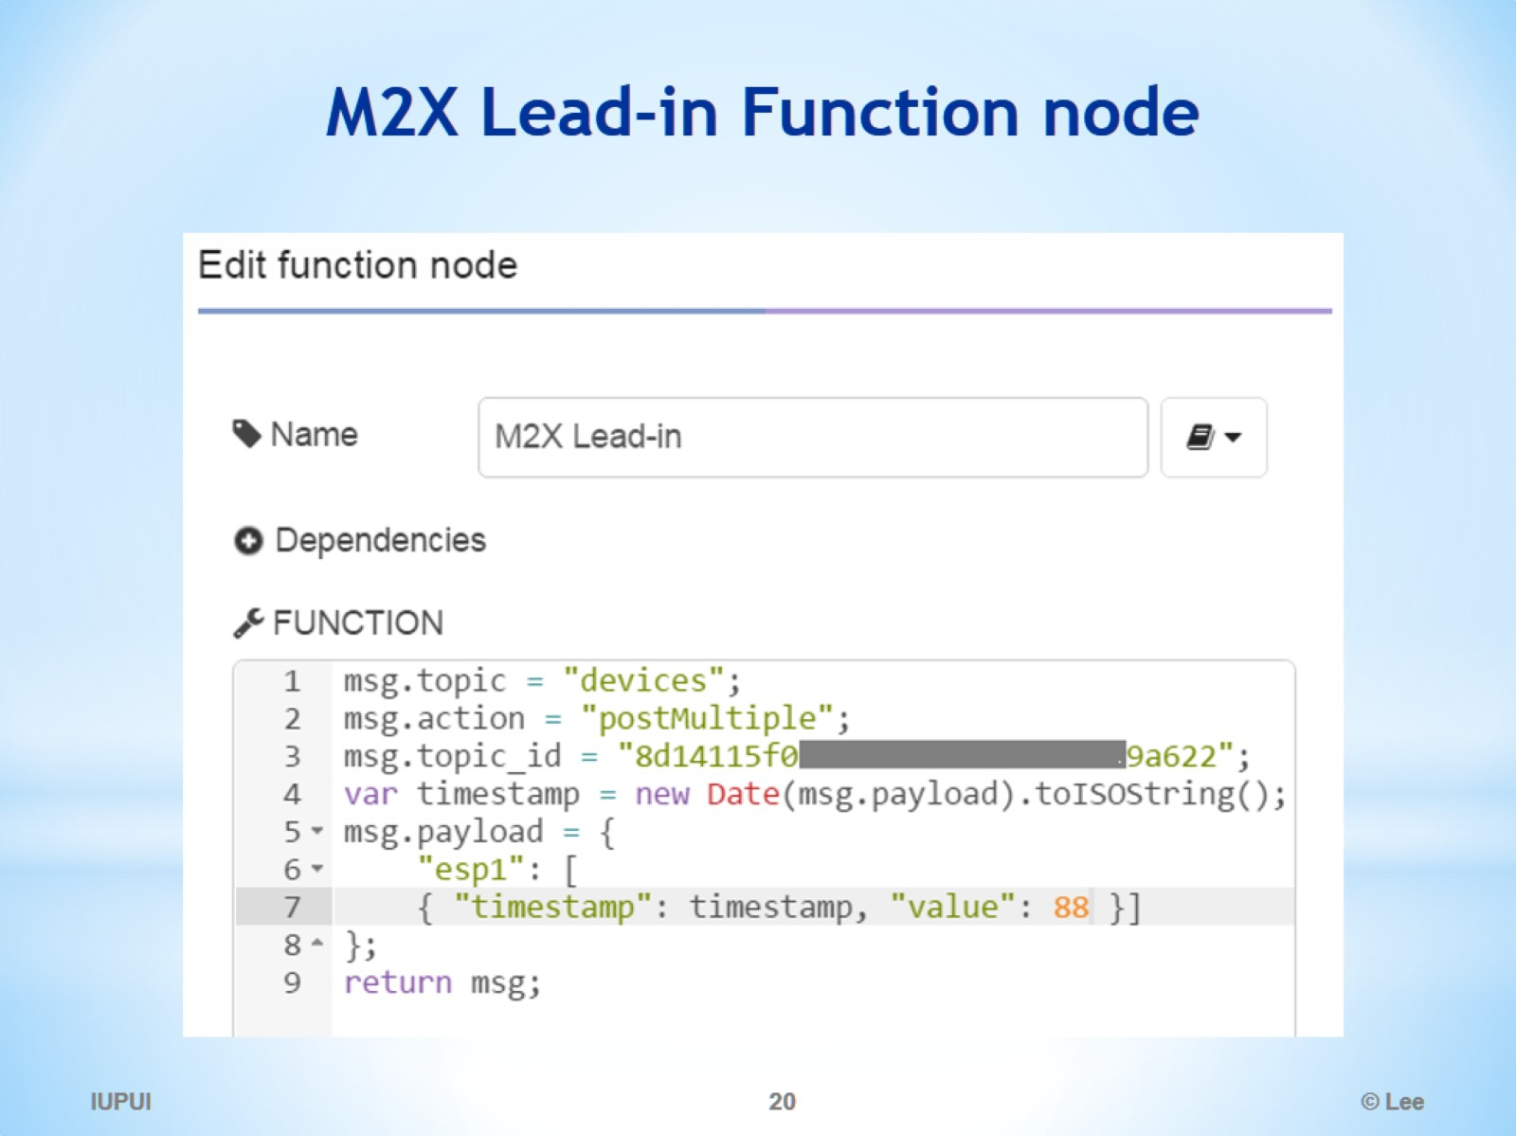
M2X Lead-in Function node

Slide 21
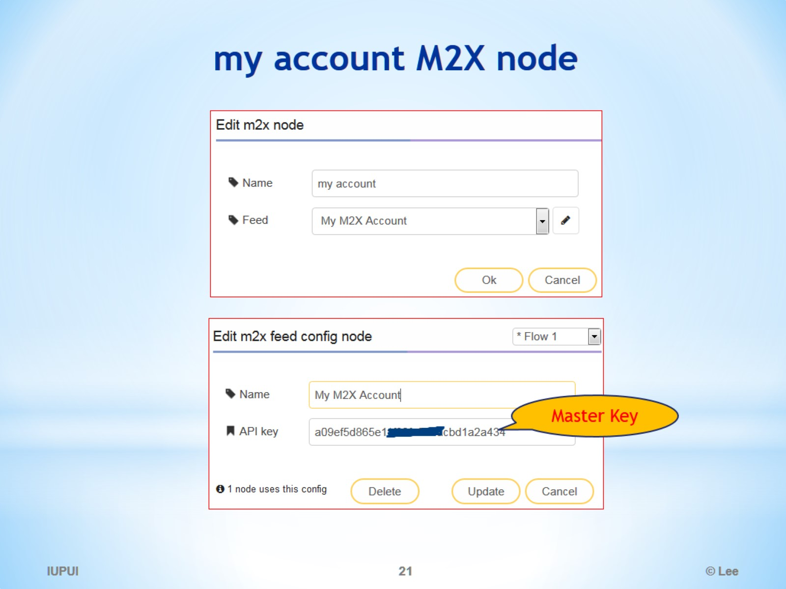
my account M2X node

Slide 22
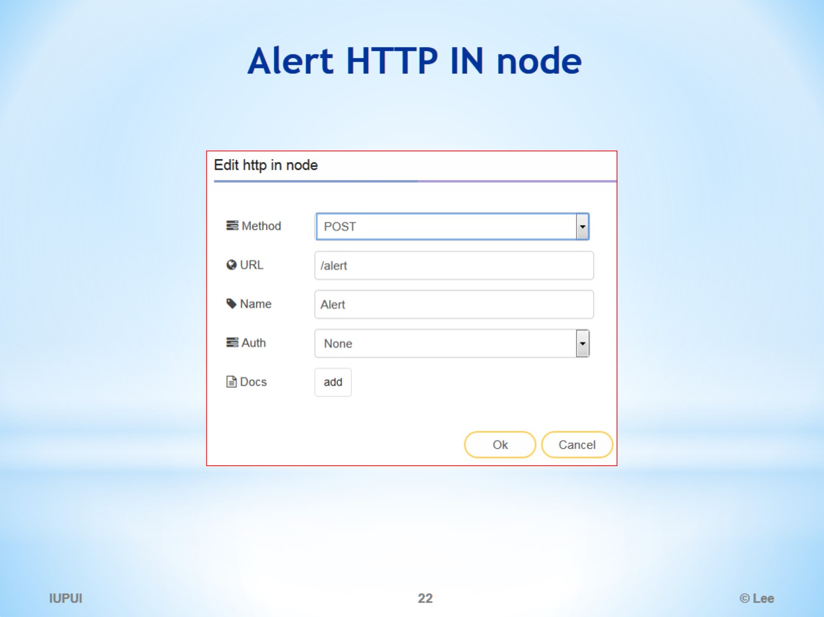
Alert HTTP IN node

Slide 23
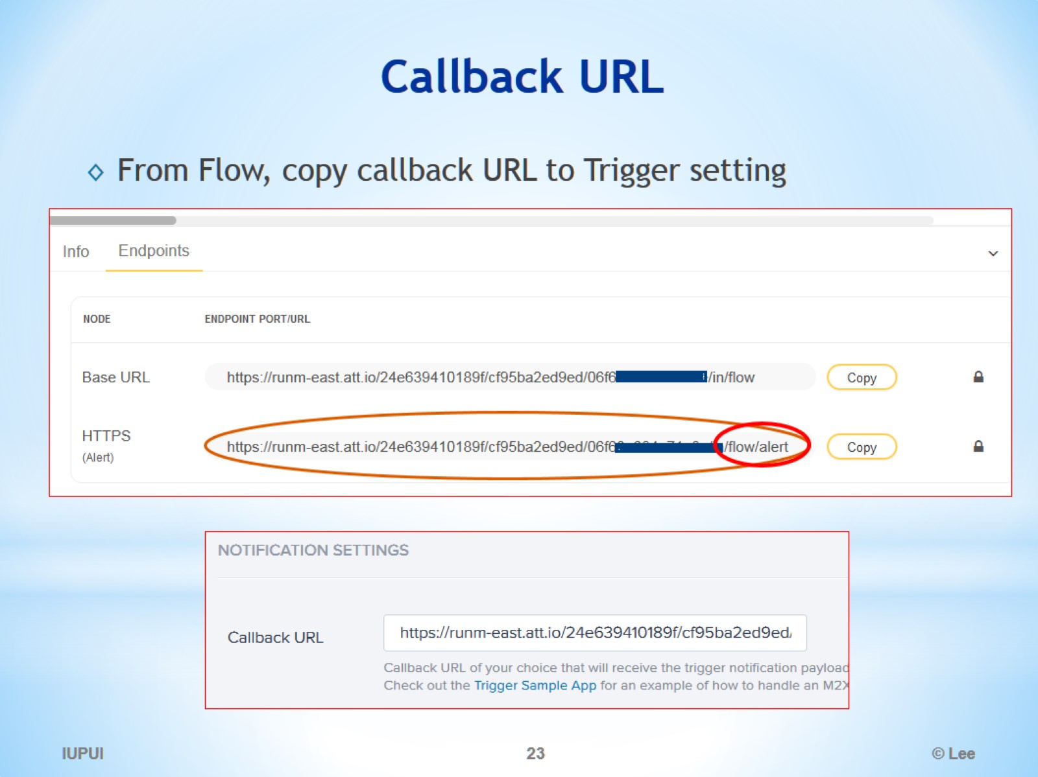
Callback URL

Slide 24
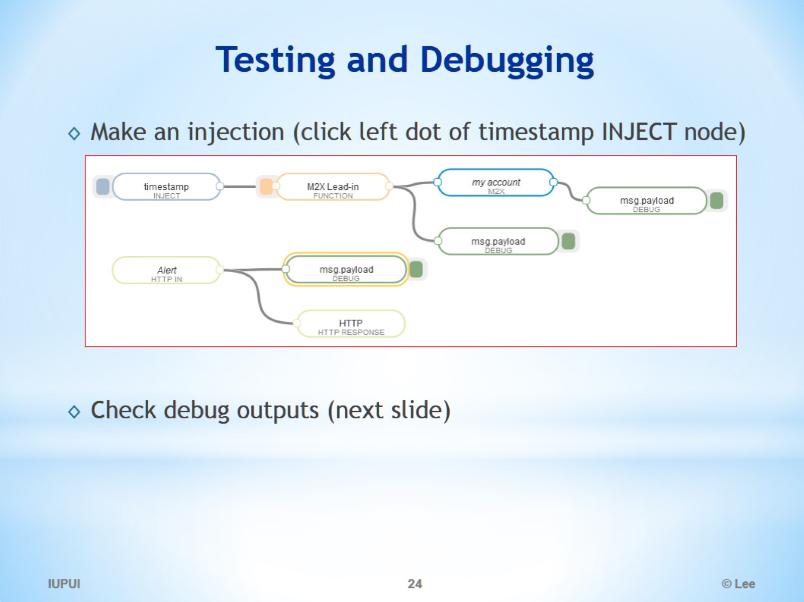
Testing and Debugging

Slide 25
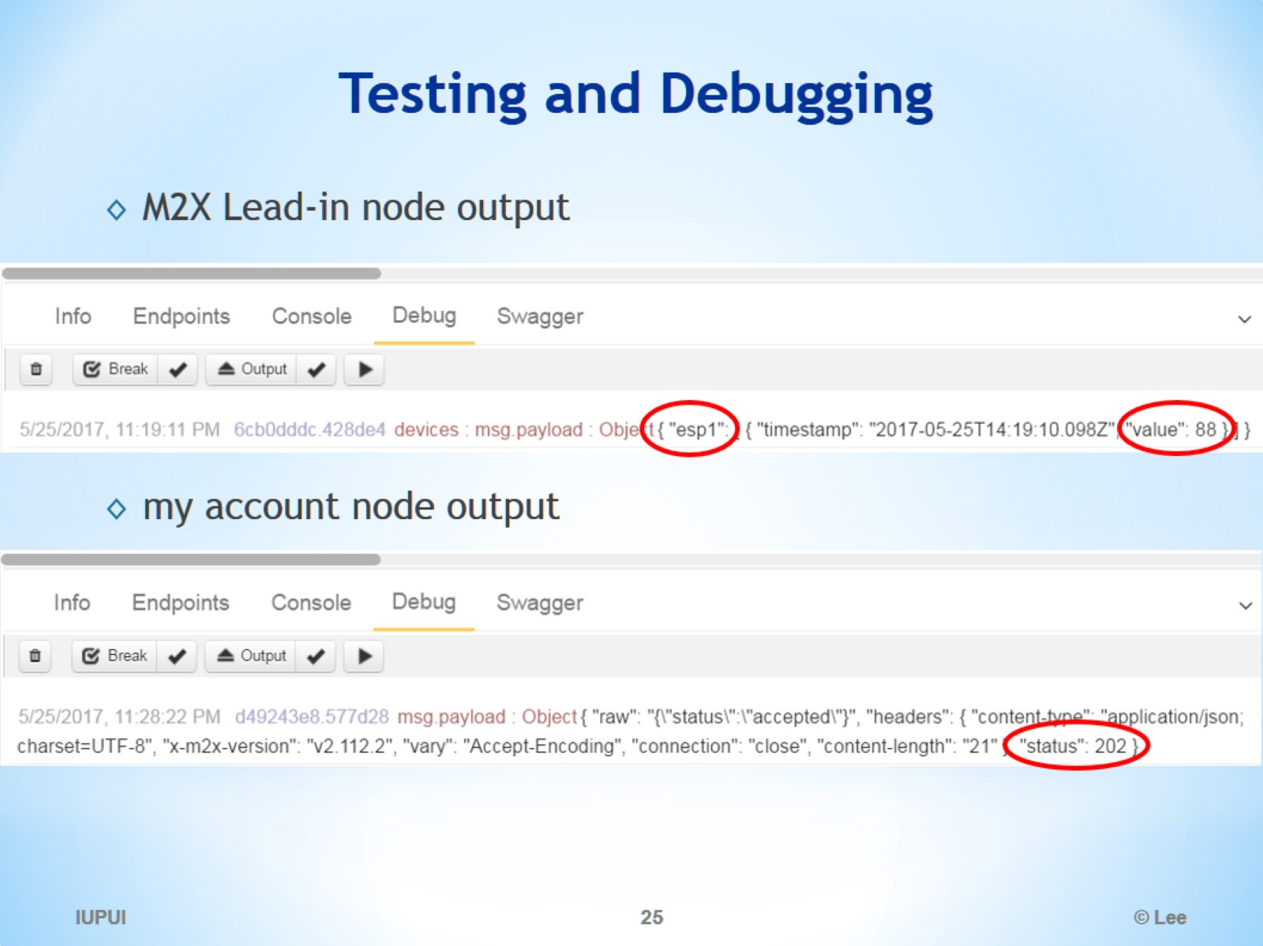
Testing and Debugging

Slide 26
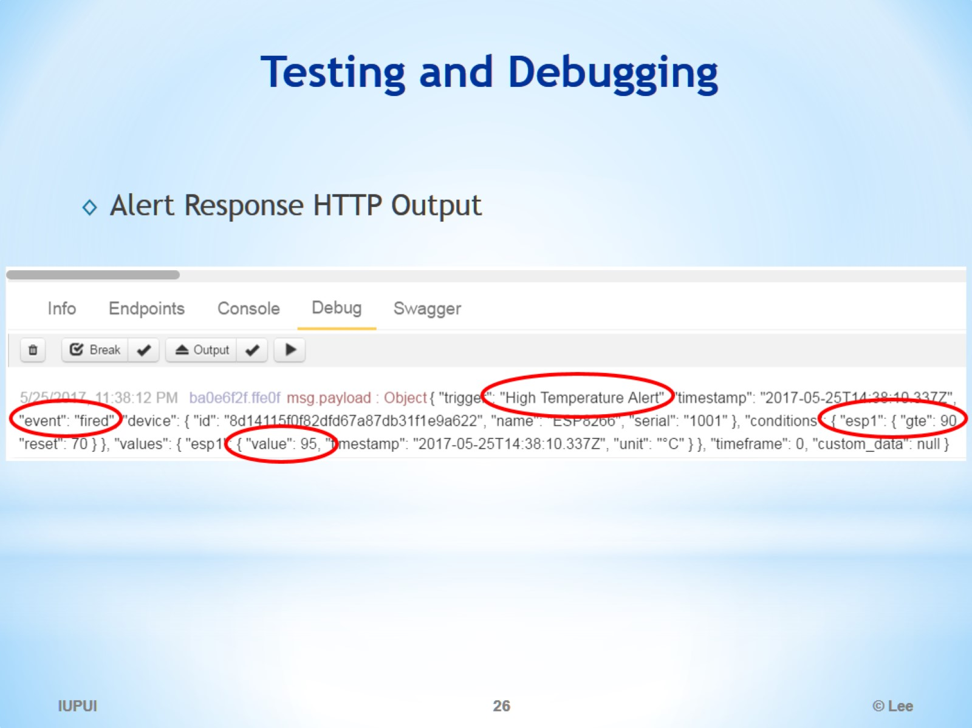
Testing and Debugging

Slide 27
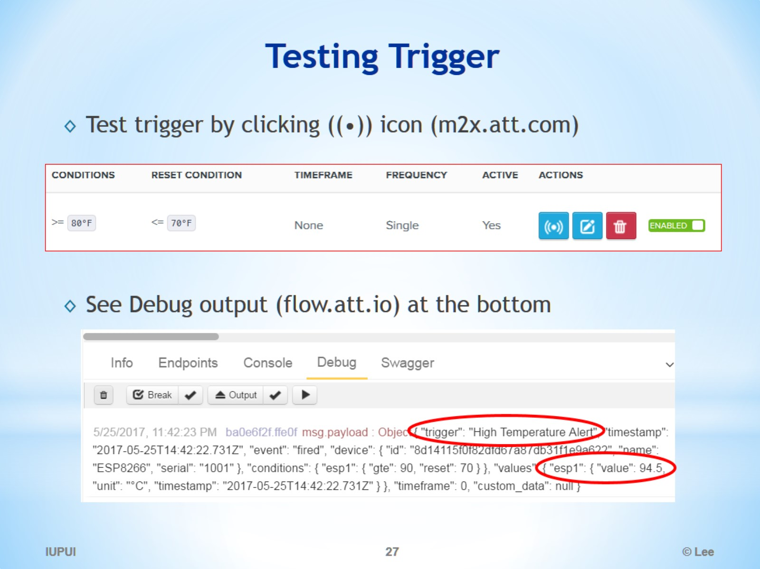
Testing Trigger

Slide 28
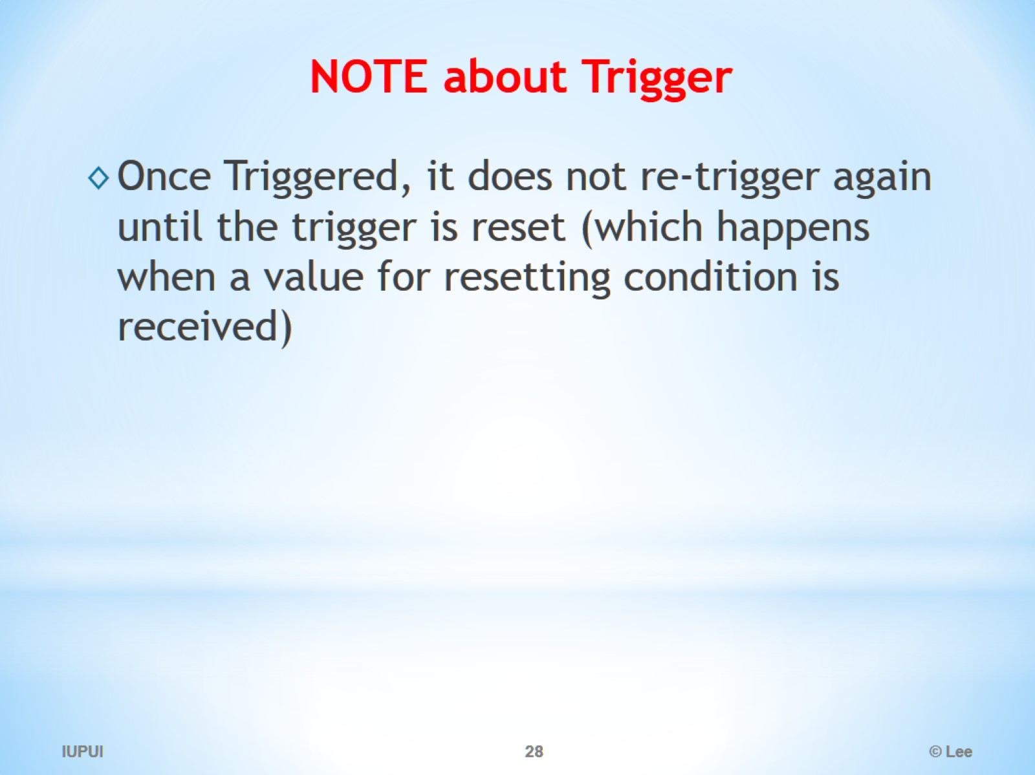
NOTE about Trigger

Slide 29
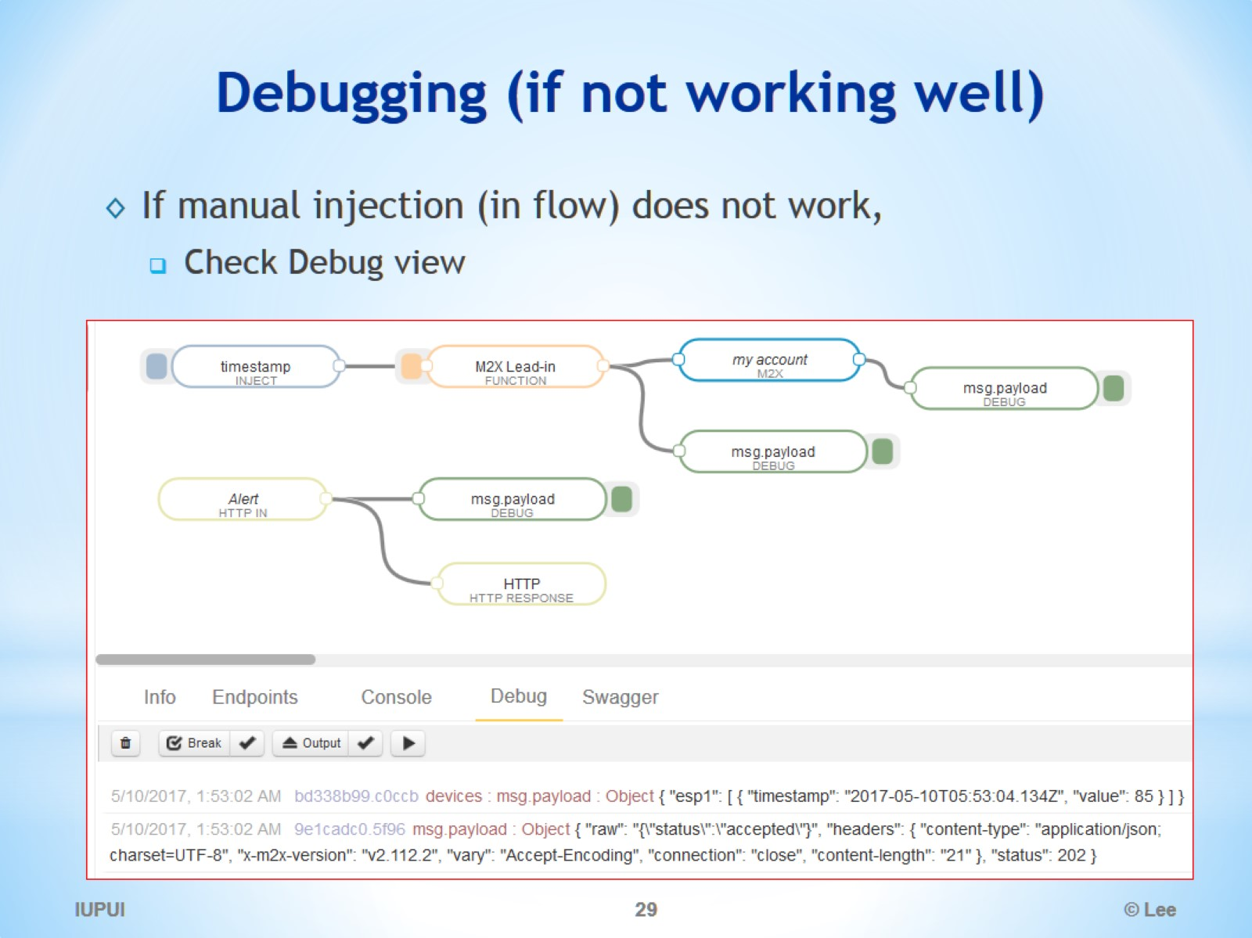
Debugging (if not working well)

Slide 30
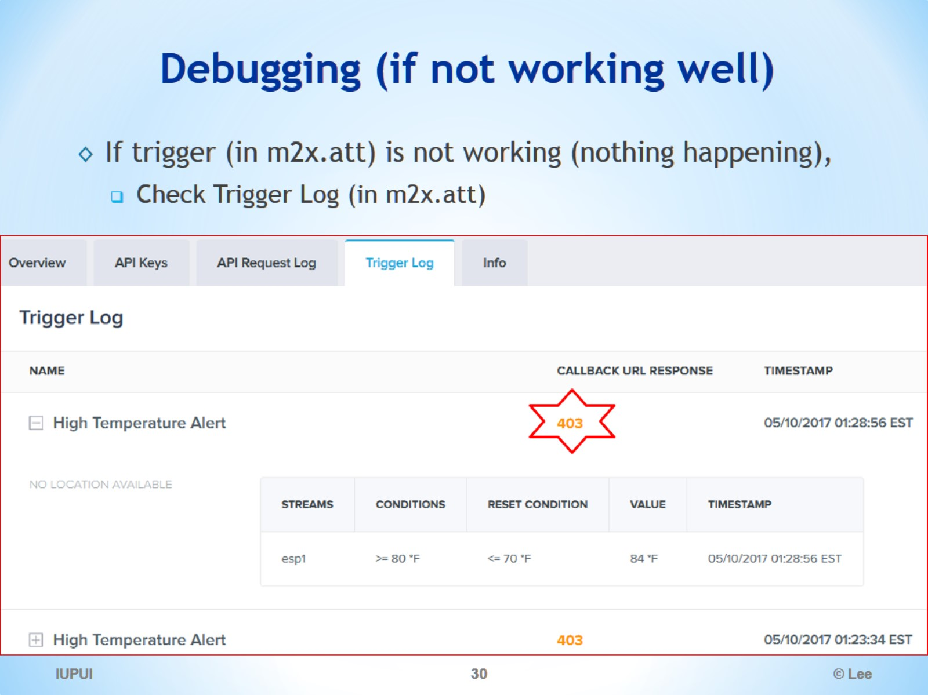
Debugging (if not working well)

Slide 31
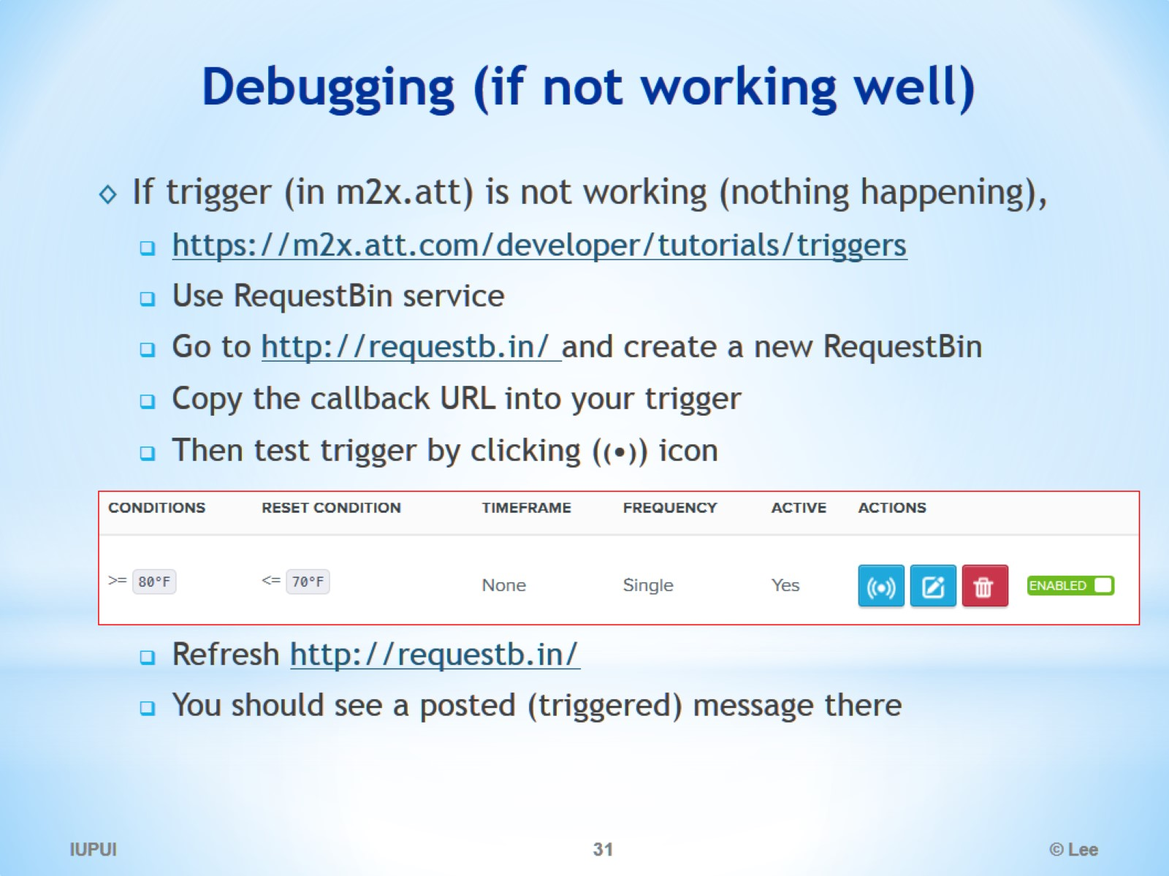
Debugging (if not working well)

Slide 32
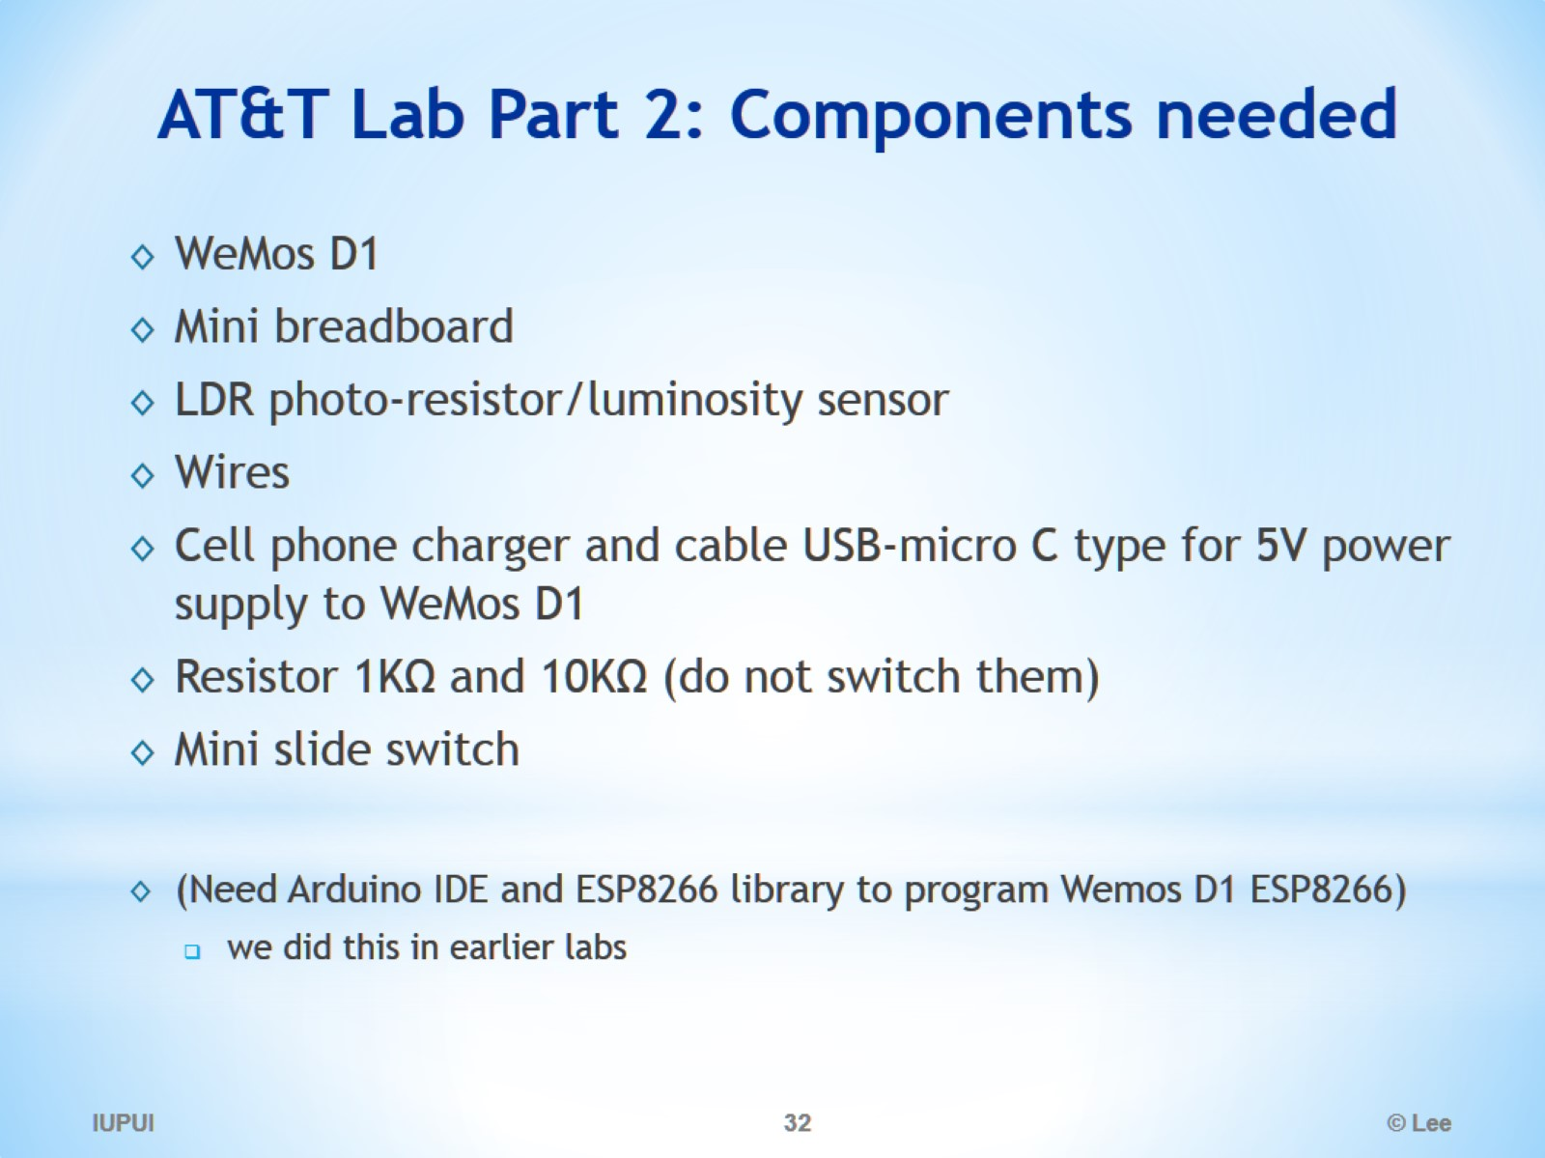
AT&T Lab Part 2: Components needed

Slide 33
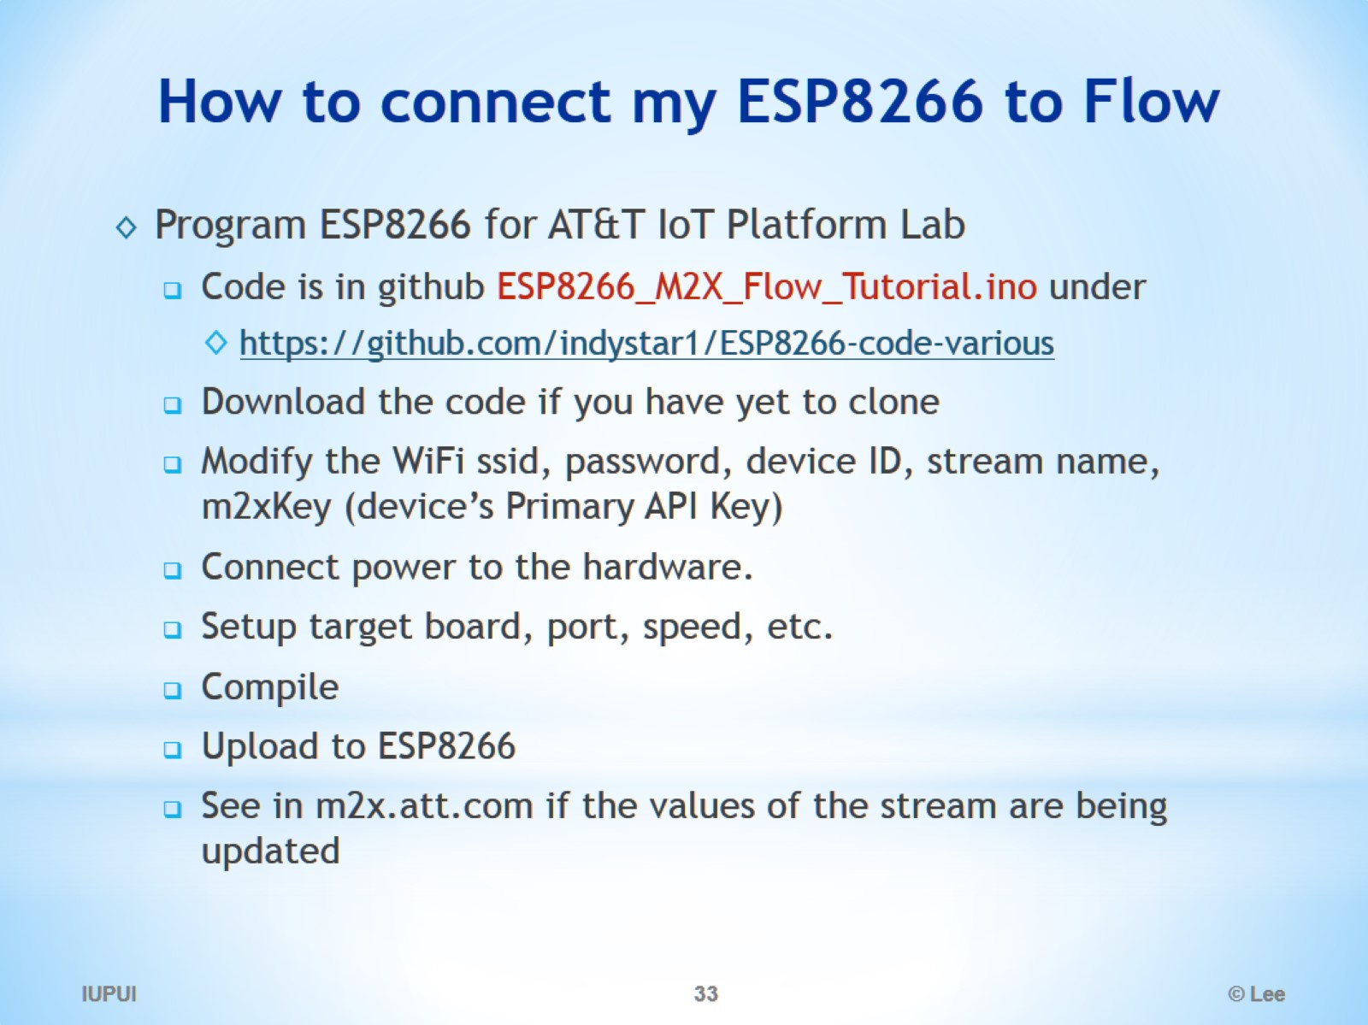
How to connect my ESP8266 to Flow

Slide 34
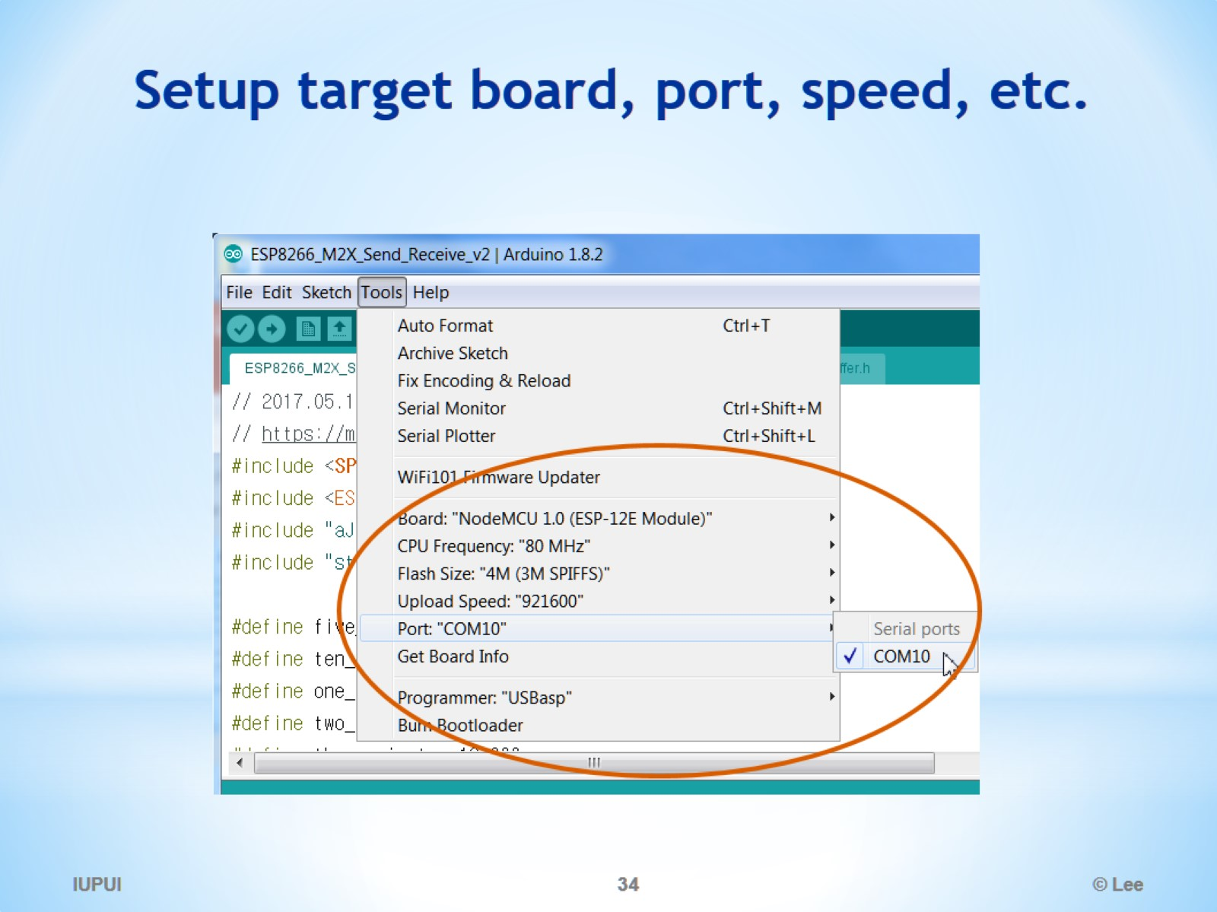
Setup target board, port, speed, etc.

Slide 35
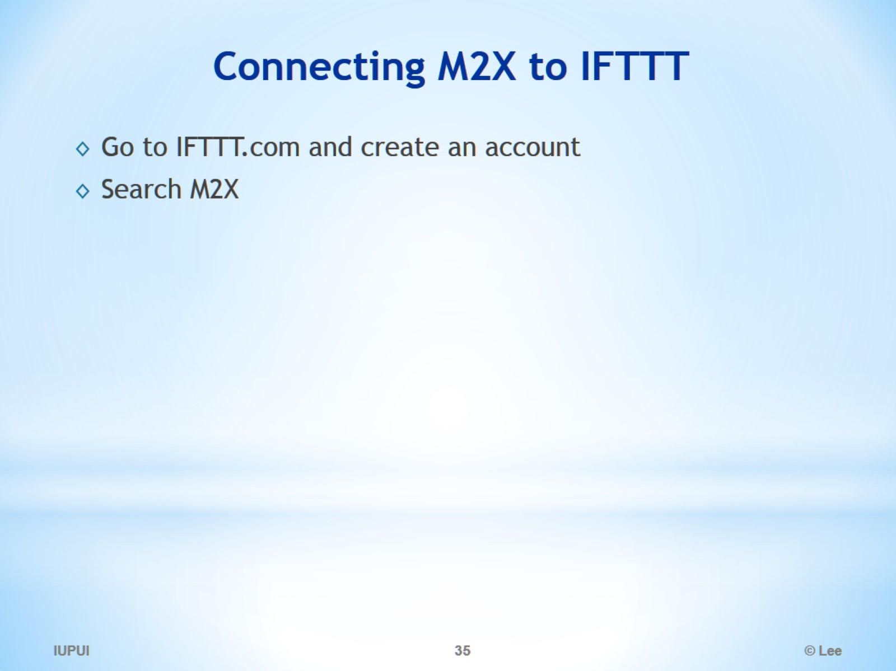
Connecting M2X to IFTTT

Slide 36
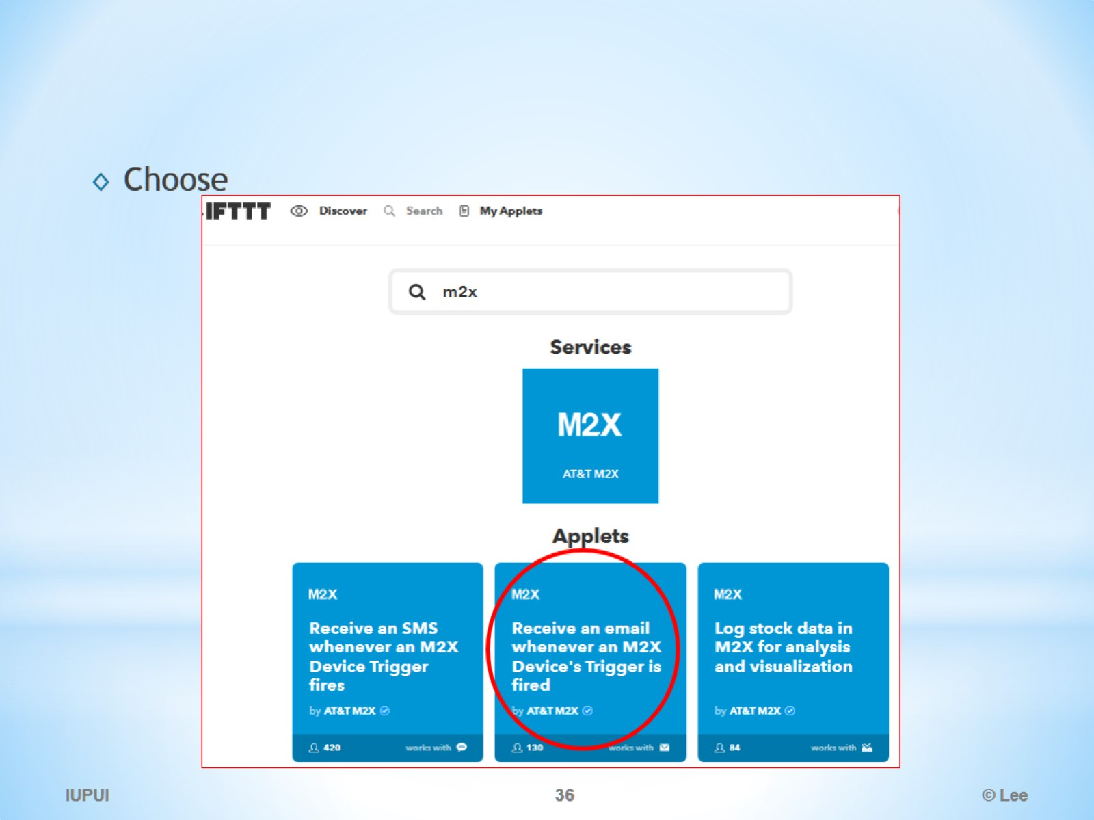

Slide 37
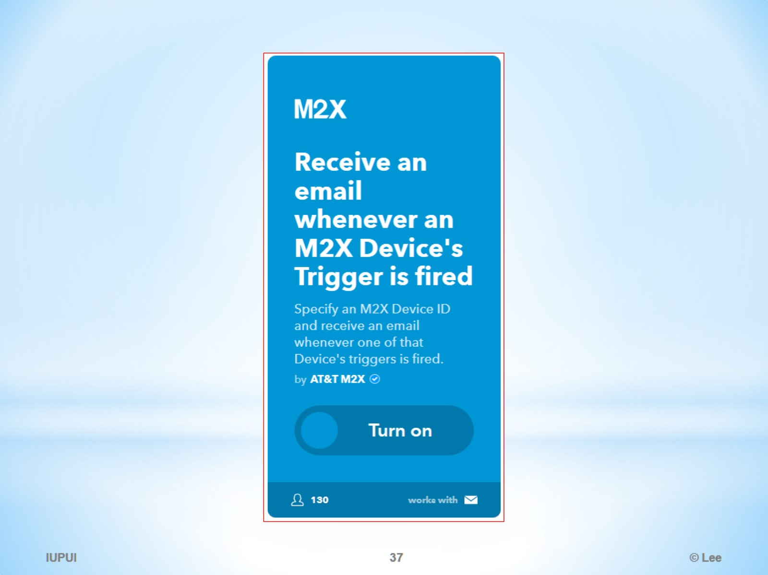

Slide 38
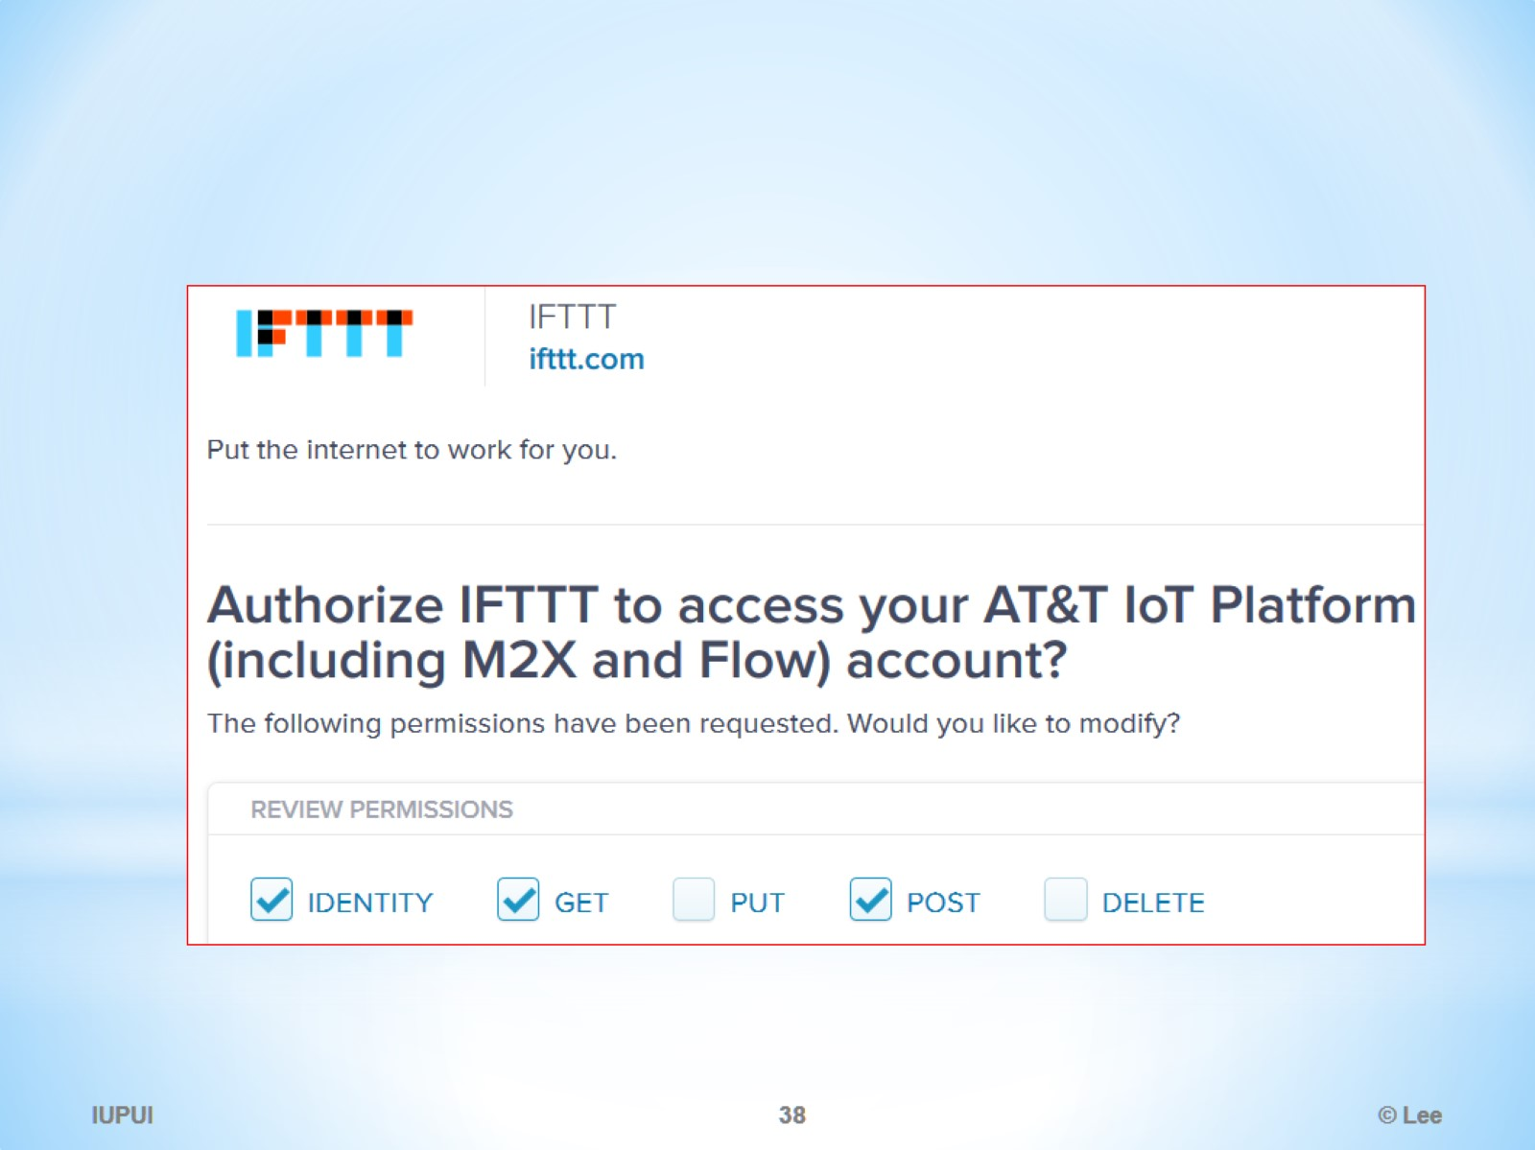

Slide 39
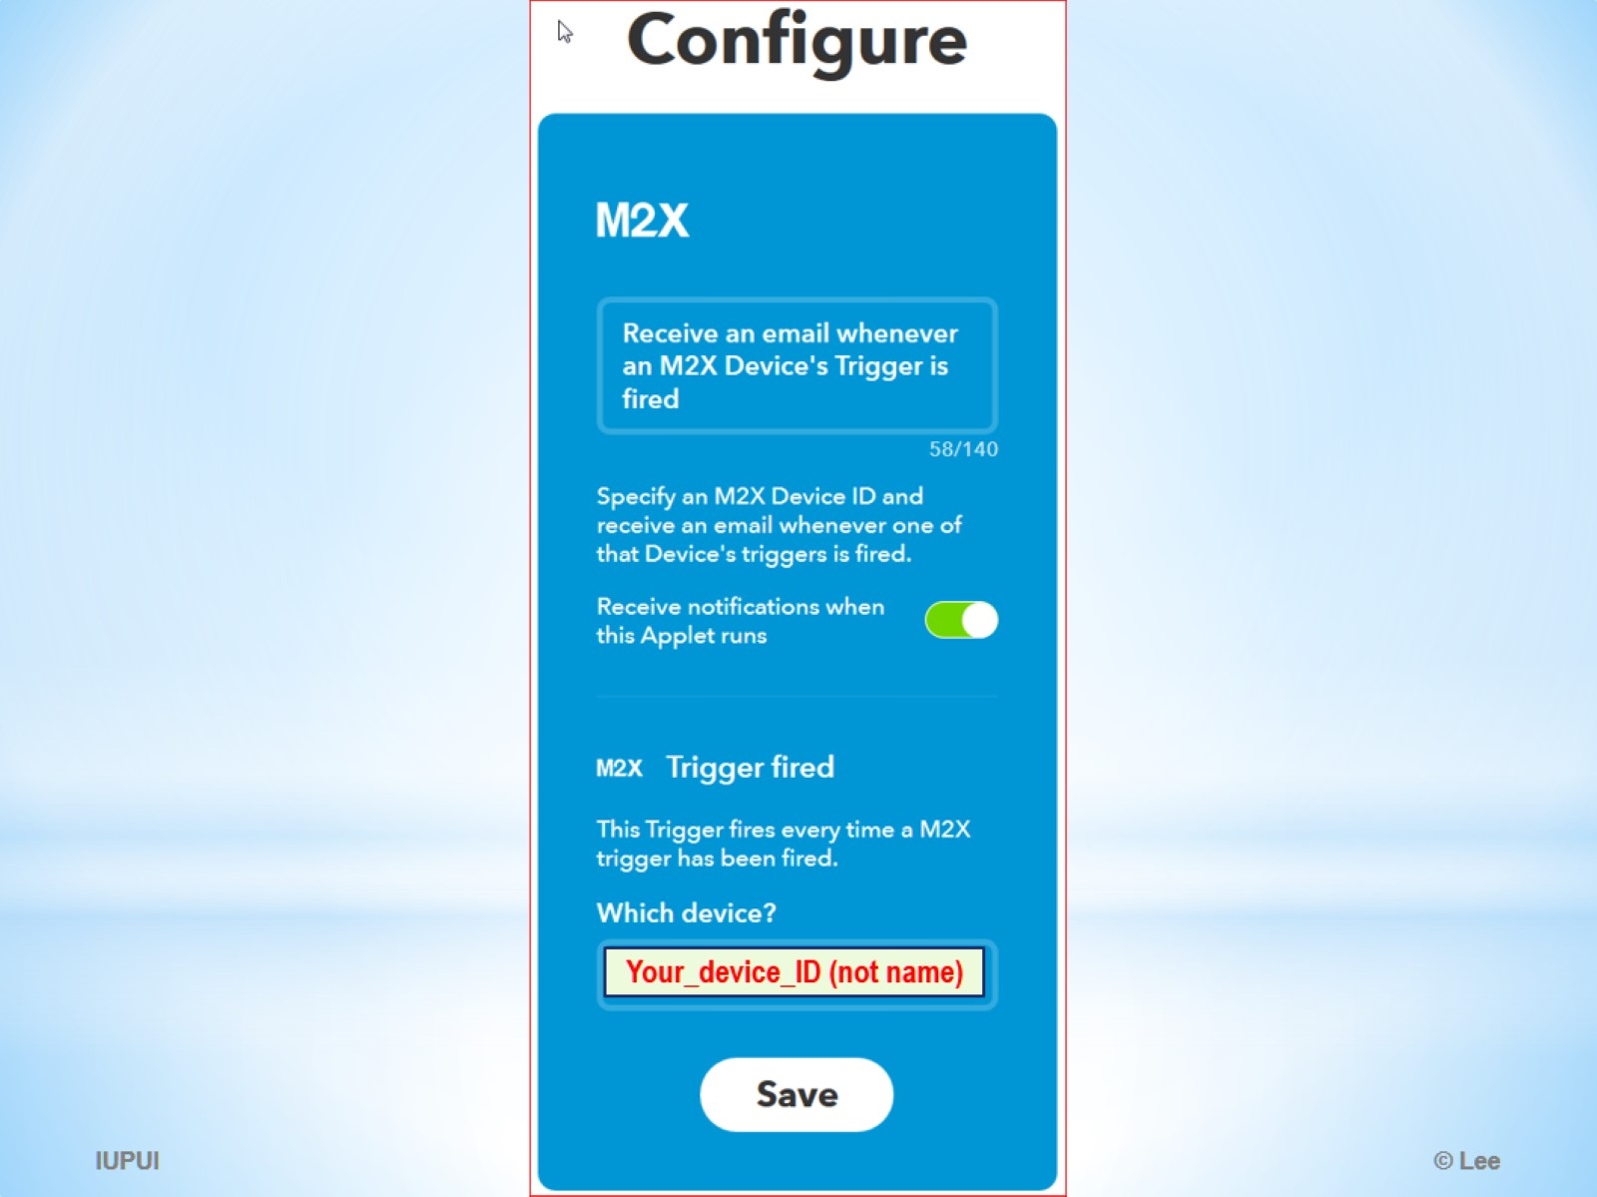

Slide 40
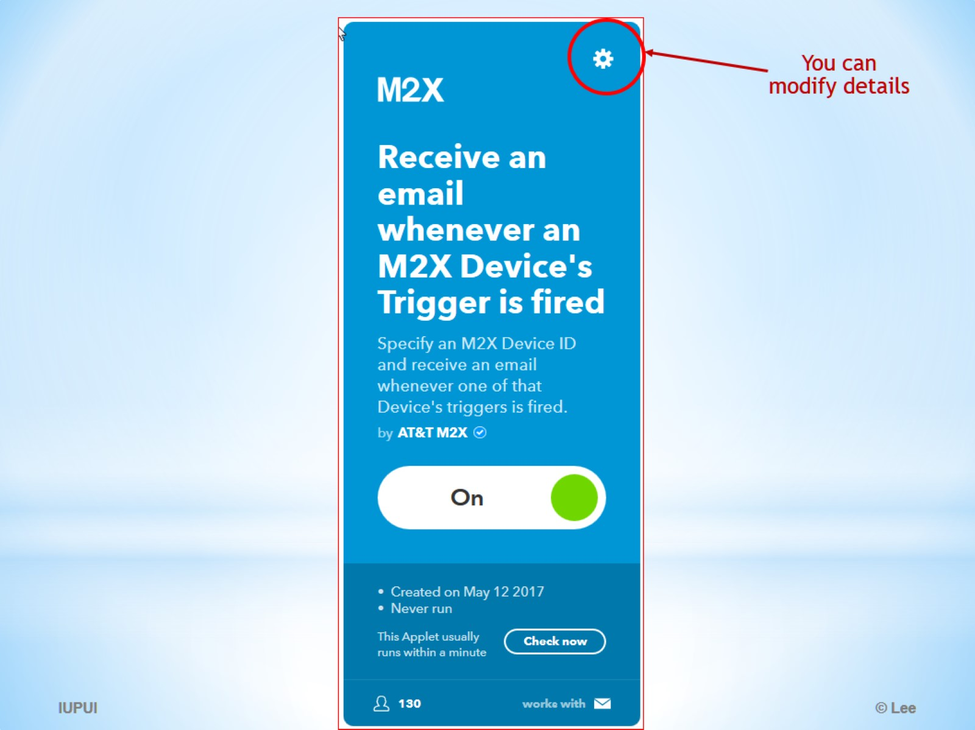

Slide 41
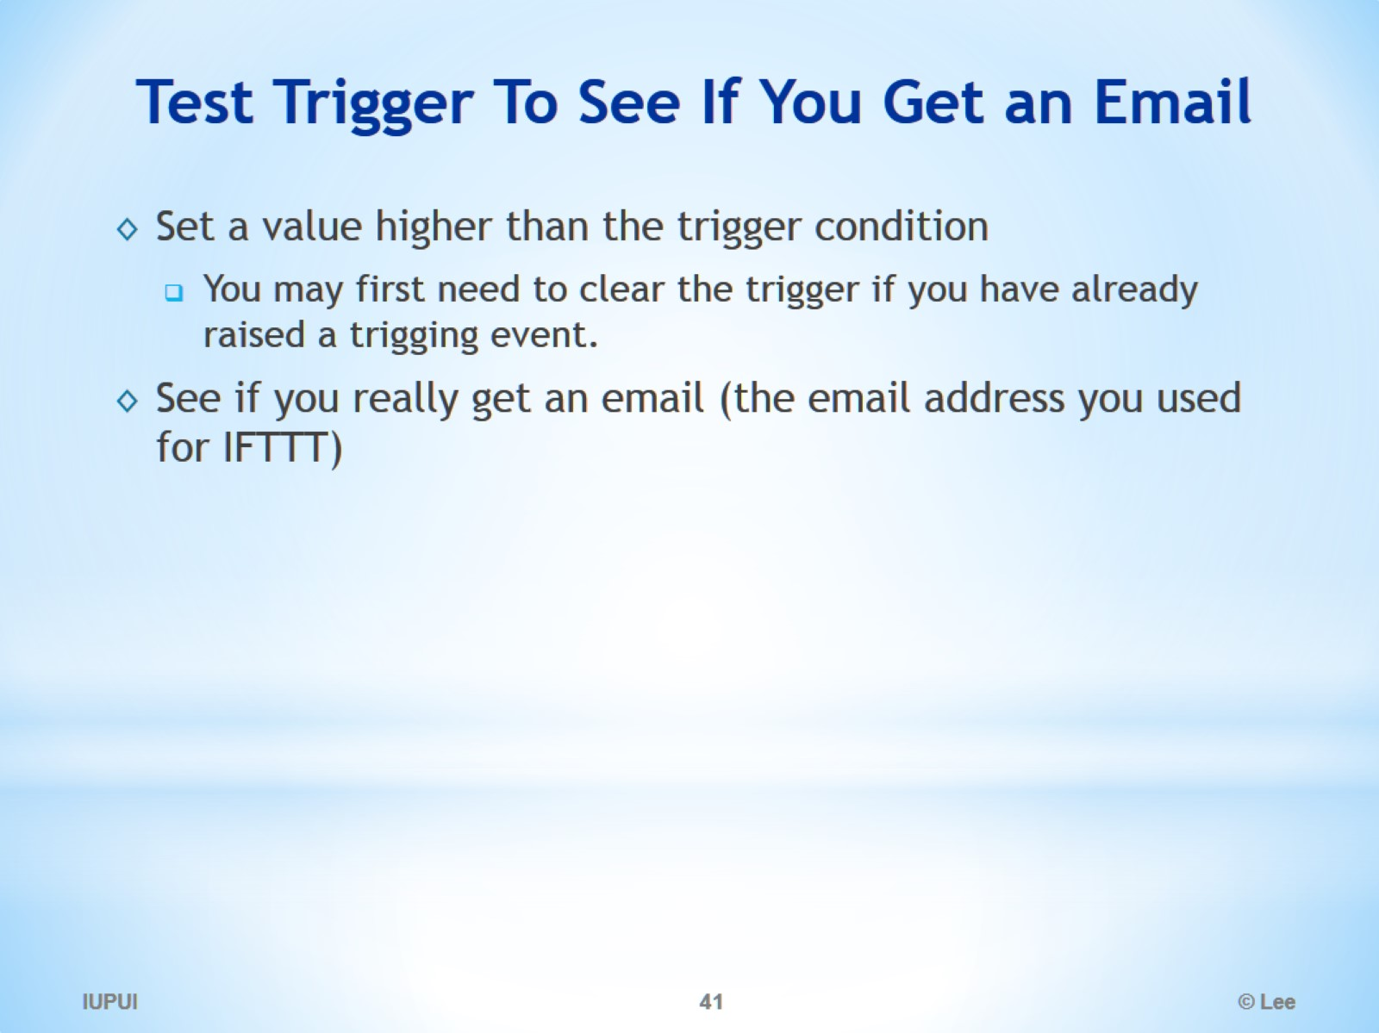
Test Trigger To See If You Get an Email

Slide 42
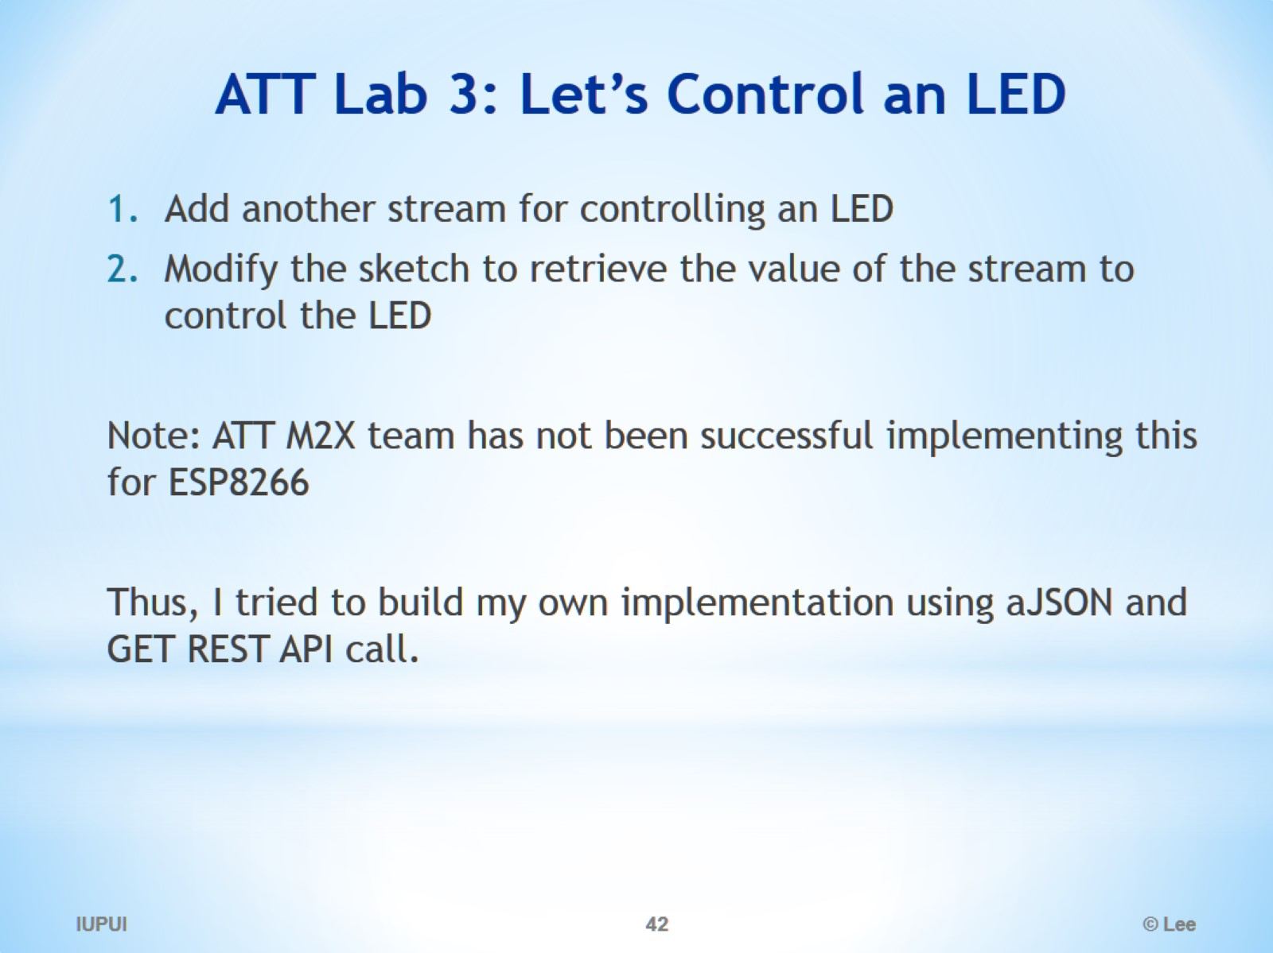
ATT Lab 3: Let’s Control an LED

Slide 43
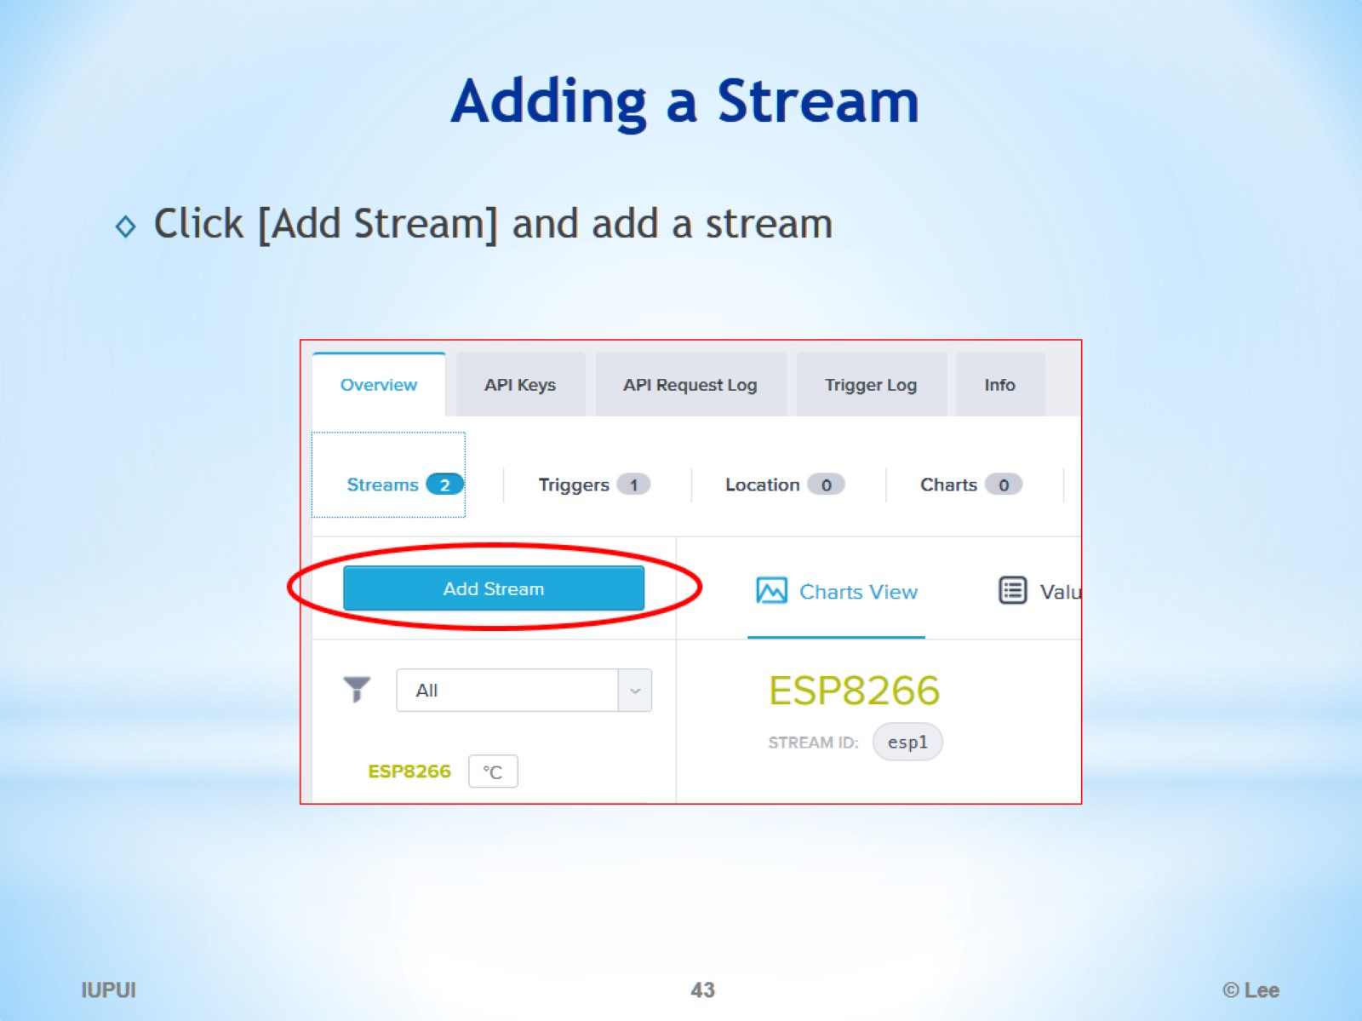
Adding a Stream

Slide 44
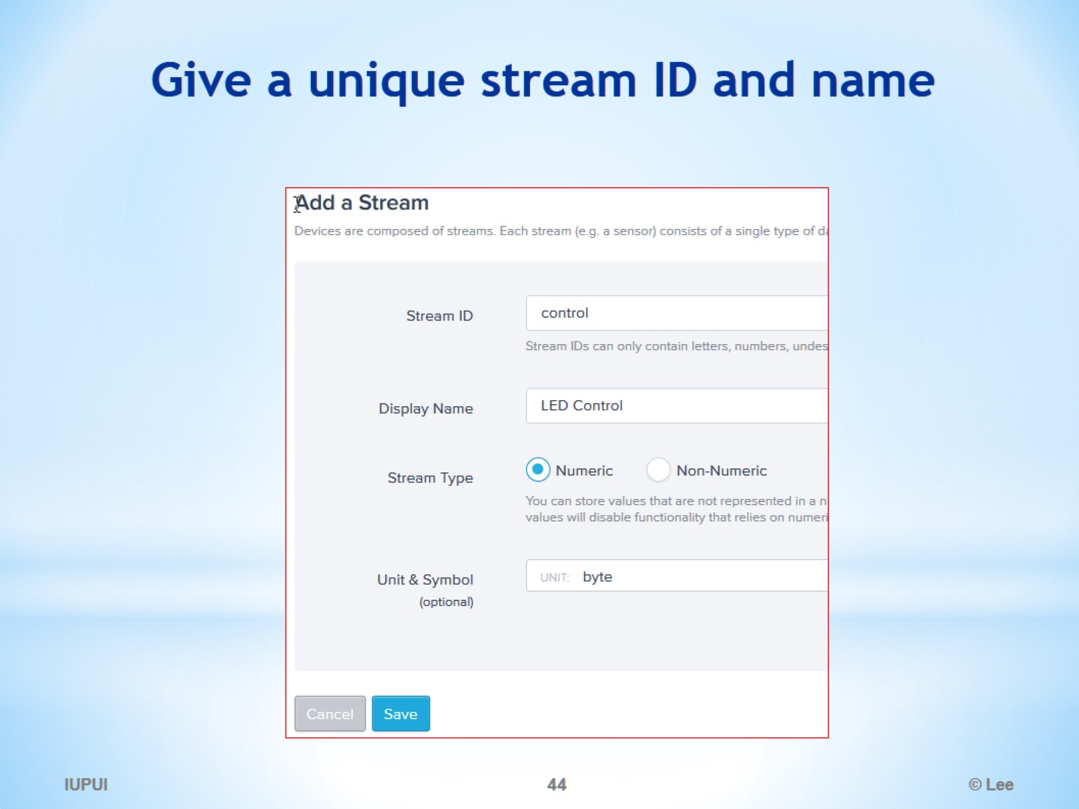
Give a unique stream ID and name

Slide 45
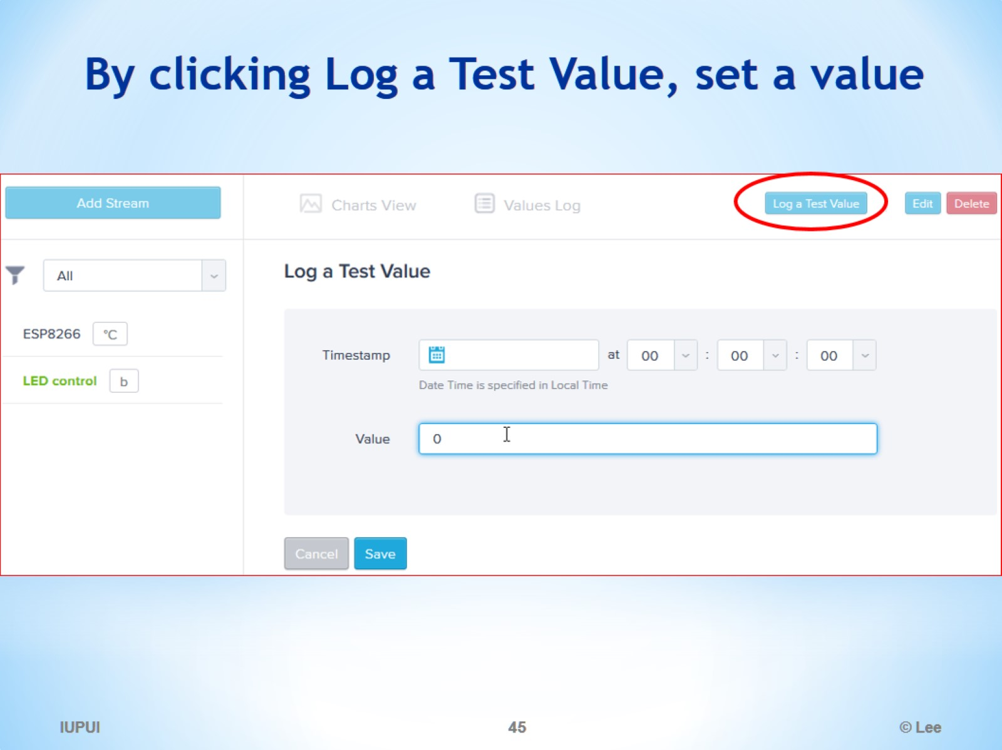
By clicking Log a Test Value, set a value

Slide 46
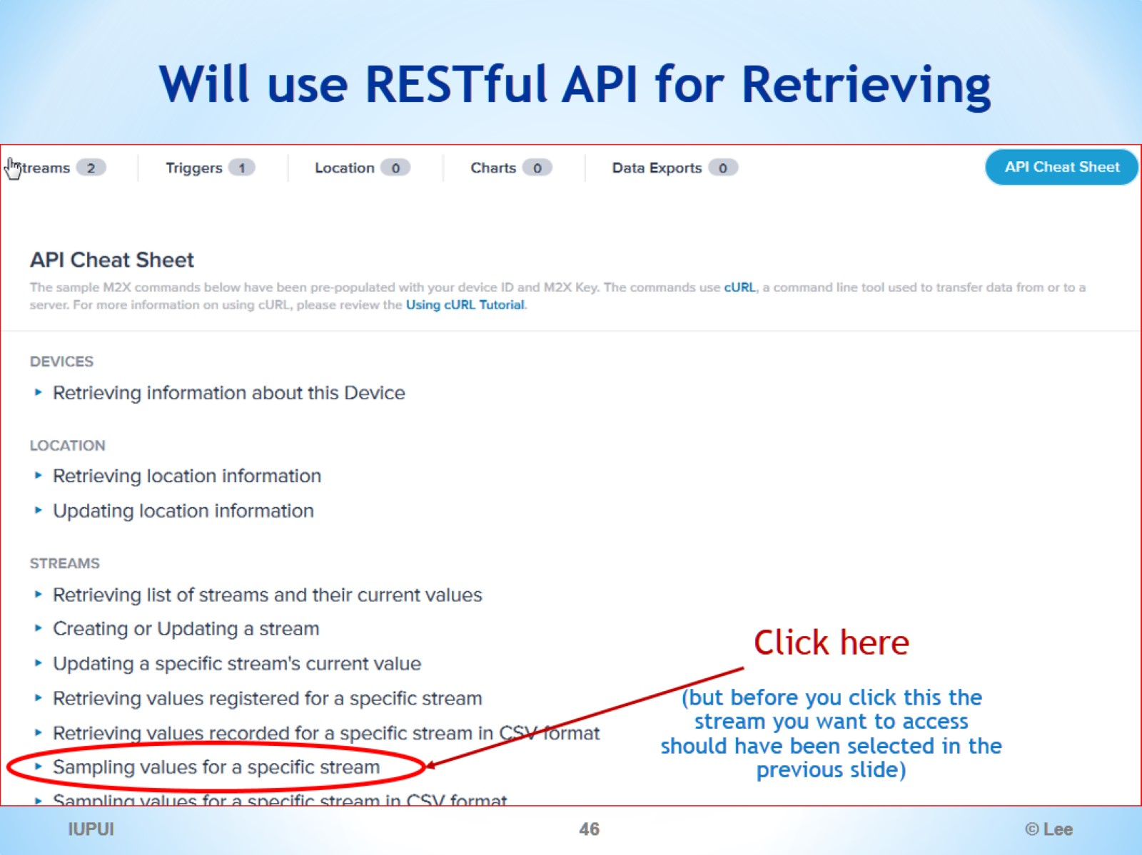
Will use RESTful API for Retrieving

Slide 47
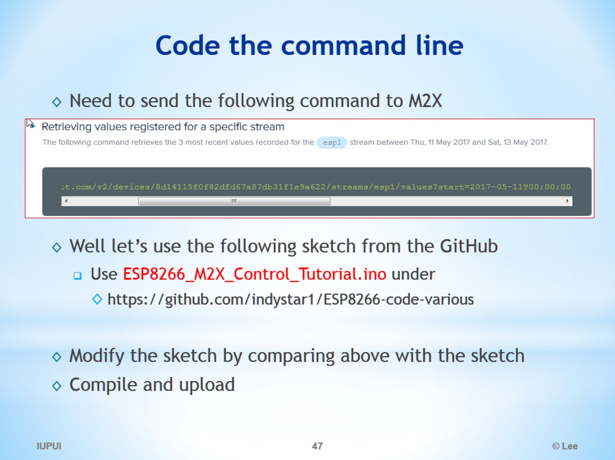
Code the command line

Slide 48
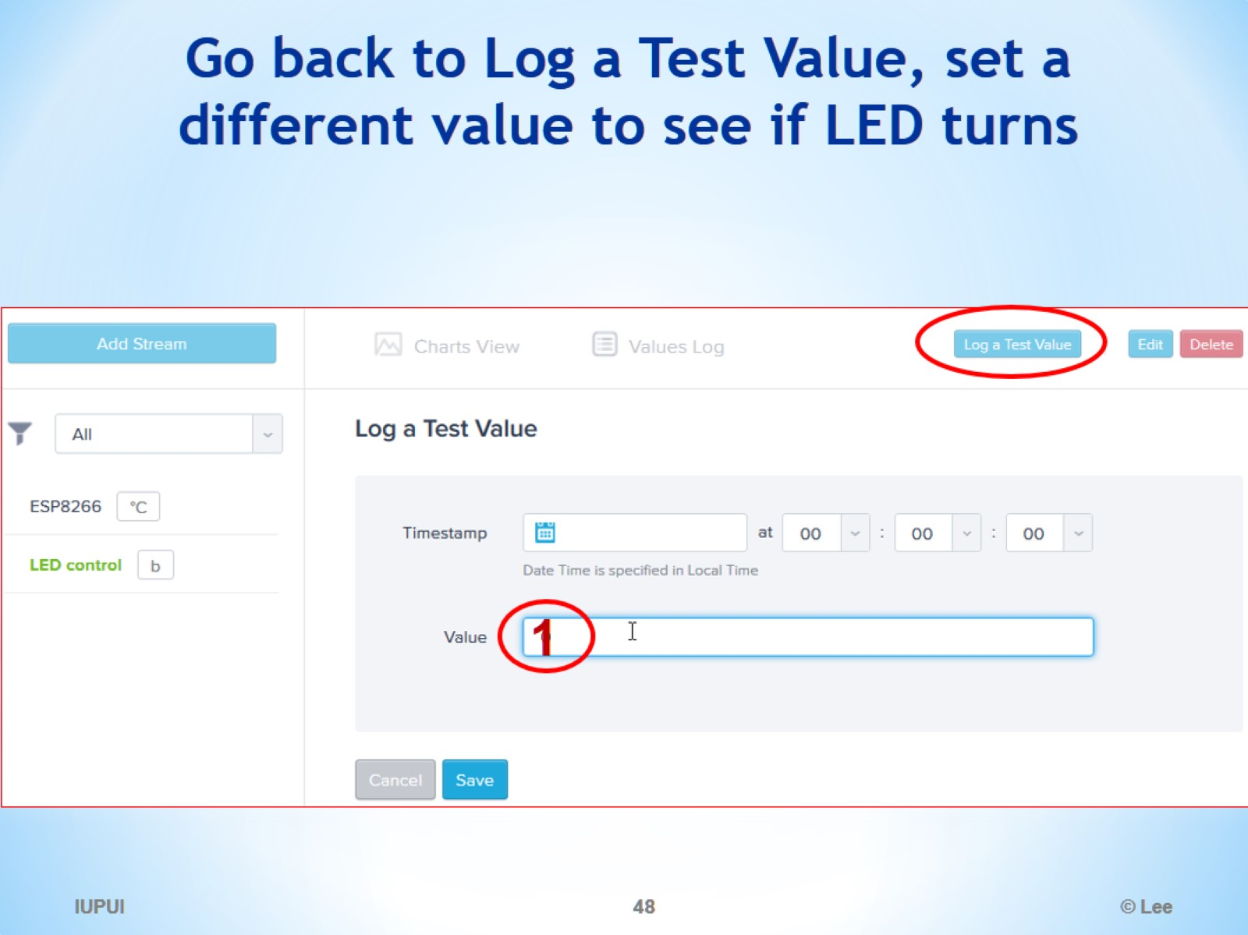
Go back to Log a Test Value, set a different value to see if LED turns

Slide 49
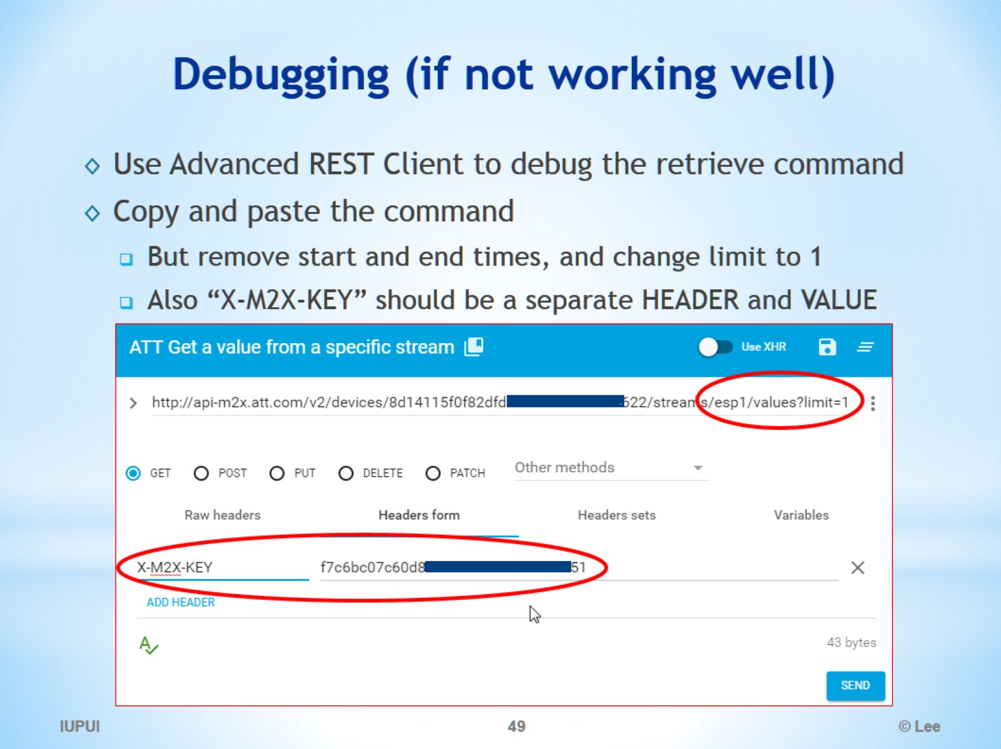
Debugging (if not working well)

Slide 50
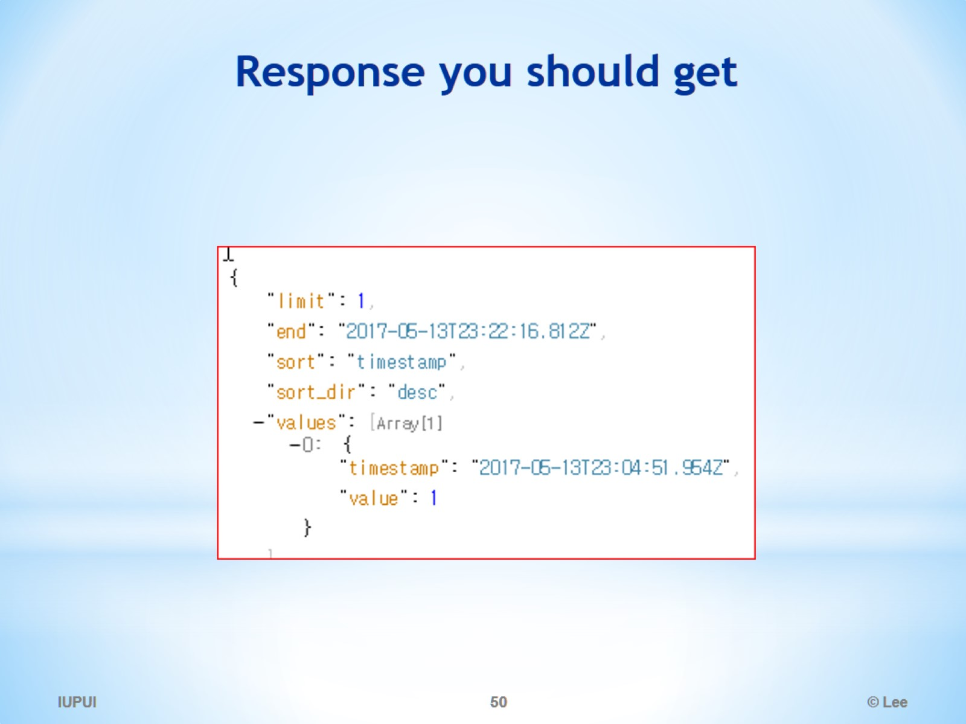
Response you should get

